Slide 1
ENGLISH PHONETICS AND PHONOLOGY
SESSION 8
RIKA MUTIARA, S.Pd., M.Hum.
PENDIDIKAN BAHASA INGGRIS, FKIP

Slide 2
Learning Outcomes
Students are able to illustrate the concepts of assimilation, dissimilation, elision, and linking.

Slide 3
Assimilation
In natural connected speech, the way that sounds belong to one word can cause changes in sounds belonging to neighboring words. It is the modification of a sound in order to make it more similar to some other sound in its neighbourhood.
Assimilation is something which varies in the extent according to speaking rate and style.
It is more to be found in rapid, casual speech.

Slide 4
Assimilation
The advantage of having assimilation is that it results in smoother, more effortless, more economical transitions from one sound to another. The speaker usually tries to conserve energy by using no more effort than is necessary to produce an utterance.
If a sound becomes more like the sound that precedes it, the process is called REGRESSIVE assimilation; if, on the other hand, a sound is modified so that it becomes more like the sound that follows it, the process is called PROGRESSIVE assimilation.

Slide 5
Assimilation
Assimilation of place, of manner, and of voicing in consonants.
Assimilation of place. A final consonant with alveolar place of articulation is followed by an initial consonant with a place of articulation that is not alveolar. For example, sound /t/ in that will become /p/ before a bilabial consonant as in that person and light blue.
Before velar consonant /t/ will become /k/ as in that case, bright color, and quite good.

Slide 6
Assimilation
Assimilation of manner: one which makes less obstruction to the airflow.
Assimilation of voice is rarely found.
When a verb carries a 3rd person singular or a noun carries plural suffix or possessive suffix, that suffix will be pronounced as s if the proceeding consonant is voiceless and z if the proceeding consonant is voiced.

Slide 7
Palatalisation
The effect of the fronting is that the velar consonant is made partly in the palatal region. This process is called PALATALISATION.

Slide 8
Labialisation
Anticipating the next segment, which is a rounded vowel, the speaker starts rounding the lips before the articulation of the consonant is completed. This assimilation process is called LABIALISATION or (ROUNDING). It can be indicated in a phonetic transcription by using the raised w after a consonant [Cw].

Slide 9
Videos
https://www.youtube.com/watch?v=i_ohrkQmzdQ
https://www.youtube.com/watch?v=Yrzg7DDo0ao
https://www.youtube.com/watch?v=t-8FkAqstTU
https://www.youtube.com/watch?v=lc2eOCVJMuQ
https://www.youtube.com/watch?v=sDDV01W20bo

Slide 10
Disssimilation
Phonological processes which ensure that differences between sounds are enhanced so that sounds become more auditorily distinct make speech perception easier. DISSIMILATION is the term used to refer to processes of that kind.
In English, the adjective forming suffix -al has two phonetic manifestations. Sometimes it is –al and sometimes it -ar.

Slide 11
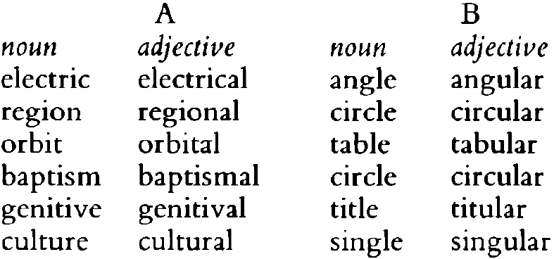
Dissimilation

Slide 12
Dissimilation
The shape -al is the base form. It is the form which you add in column A where the last consonant of the noun is a sound other than [1].
The shape -ar is the alternant which is normally added where the last consonant of the noun is [1]. The addition of -al after a root ending in [1], which would have resulted in two [1] sounds merely separated by a schwa, is thus avoided.

Slide 13
Elision
Under certain circumstance, sounds disappear.
Ellision is typical of rapid, casual speech.
Lost of vowel after /p/, /t/, and /k/. In words like potato, tomato, and canary, the vowel in the first syllable may disappear.
Loss of final /v/ in of before consonants

Slide 14
Ellison
Contraction of grammar.
Had and would are spelt ‘d. Pronounced d after vowels and əd after consonants.
Have is spelt ‘ve. Pronounced v after vowels and əv after consonants.
Are is spelt ‘re. Pronounced ə after vowels usually with some changes in the proceeding vowels

Slide 15
Linking
In real connected speech, sometimes we link words together.
The use of linking r, the phoneme r cannot occur in syllable final position in RP but when a word’s spelling suggest final r, and a word beginning with a vowel follows, the pronunciation becomes

