Slide 1
INTRODUCTION TO LITERATURE
SESSION 1
Prayogo Hadi Sulistio, M.Pd
PENDIDIKAN BAHASA INGGRIS, FKIP

Slide 2
VISI DAN MISI UNIVERSITAS ESA UNGGUL

Slide 3
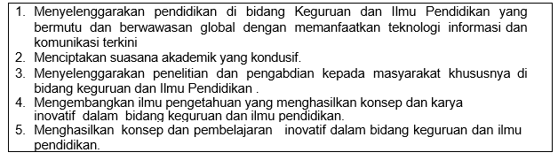
VISI FKIP
MISI FKIP

Slide 4
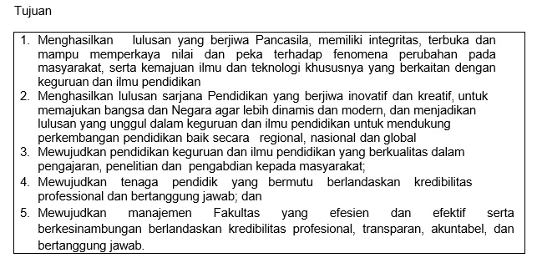
TUJUAN FKIP

Slide 7
Sessions before mideterm test
01. Introduction to Subject Matter
02. Purposes of literature
03. History of English Literature Part 1
04. History of English Literature Part 2
05. Critical Theories Literature Part 1
06. Critical Theories Literature Part 1
07. Review

Slide 8
Sessions after midterm test
08. Elements of fiction
09. Elements of fiction 2
10. Elements of Drama 1
11. Elements of Drama 2
12. Elements of poetry 1
13. Elements of Poetry 2
14. Review

Slide 9
RULES OF THE CLASS
Try your best to speak English in the classroom
Come to the class on time
Bring the dictionary (digital or printed)
Submit assignment on time
Do your project

Slide 10
LEARNING OUTCOME
Students are able to explain the meaning of literature.

Slide 11
What is literature? What is Text?
Literature can refer to anything written.
Ex: The Department
of Agriculture will, upon request, send an applicant “literature on canning tomatoes.” People who ask for such material expect it to be clear and informative, but they do not expect it to be interesting in itself. (barnet et al, 2008: 3)

Slide 12
What is literature? What is Text?
Literature is referred to as the entirety of written expression, with the restriction that not every written document can be categorized as literature in the more exact sense of the word.
The definitions, therefore, usually include additional adjectives such as “aesthetic” or “artistic”(Klarer, 1999)

Slide 13
What is literature? What is Text?
Etymologically, the Latin word “litteratura” is derived from “littera” (letter), which is the smallest element of alphabetical writing.
The word text is related to “textile” and can be translated as “fabric”: just as single threads form a fabric, so words and sentences form a meaningful and coherent text.

Slide 14
What is literature? What is Text?
Basic pupose of literary production is the human wish to leave behind a trace of oneself through creative expression, which will exist detached from the individual and, therefore, outlast its creator.
Earliest literary production in the form of picture in caves. Why visual signs or pictorial dimension?

Slide 15
What is literature? What is Text?
Acoustic element, the spoken word, is an integral part of literature, for the alphabet translates spoken words into signs.
Before writing developed as a system of signs, whether pictographs or alphabets, “texts” were passed on orally.

Slide 16
What is literature? What is Text?
This predecessor of literary expression, called “oral poetry,” consisted of texts stored in a bard’s or minstrel’s memory which could be recited upon demand.
Audio-literature and the lyrics of songs display the acoustic features of literary phenomena.

Slide 17
What now?
The visual in literary texts, as well as the oral dimension, has been pushed into the background in the course of history.
While in the Middle Ages the visual component of writing was highly privileged in such forms as richly decorated handwritten manuscripts

Slide 18
What now?
Many authors and critics have deliberately left the traditional paths of literature, abandoning old textual forms in order to find new ways of literary expression and analysis.
Visual and acoustic elements are being reintroduced into literature, and media, genres, text types and discourses are being mixed.

Slide 19
Thank you

