Slide 1
TEFL Methodology
SESSION 1
Prayogo Hadi Sulistio, M.Pd
PENDIDIKAN BAHASA INGGRIS, FKIP

Slide 2
VISI DAN MISI UNIVERSITAS ESA UNGGUL

Slide 3
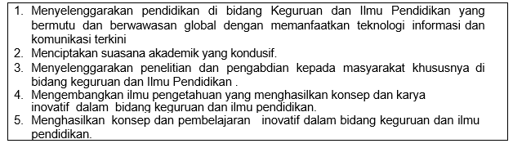
VISI FKIP
MISI FKIP

Slide 4
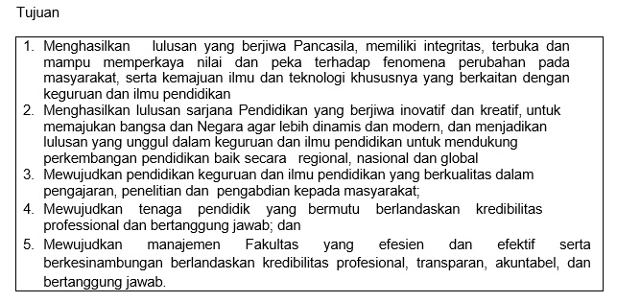
TUJUAN FKIP

Slide 7
Sessions before mideterm test
01. Introduction to Subject Matter
02. History of Language Teaching
03. Approaches and methods in ELT
04. Bloom Taxonomy in ELT
05. Assessment in ELT
06. Second language Acquisition
07. Theories of Teaching Listening

Slide 8
Sessions after midterm test
08. Teaching Listening Demonstration
09. Theories of Teaching Reading
10. Teaching Reading Demonstration
11. Theories of Teaching Speaking
12. Teaching Speaking Demmonstration
13. Theories of Teaching Writing
14. Teaching Writing Demonstration

Slide 9
RULES OF THE CLASS
Try your best to speak English in the classroom
Come to the class on time
Bring the dictionary (digital or printed)
Submit assignment on time

Slide 10
LEARNING OUTCOME
Understand basic concept of learning-teaching process, method, techniques, and evaluation in learning teaching process in English Language Teaching (ELT).
Develop students’ knowledge, principles, practical skills, , techniques and awareness for teaching the four skills and language components (teaching listening skills, reading, speaking, writing skills, grammar, pronunciation and integrated skills)
Determine and adapt teaching strategies which are relevant to students’ needs, school settings and contexts.

Slide 11
Scoring System
Assignment: 20%
Presence: 10%
Mid Term Test: 30%
Final Term Test: 40%

Slide 12
Trends of Language Learning in 21st century
Saying that language learning is easy
Vague, hollow promises that can't be proven.
Authoritative teacher attitudes.
Complaining about cutbacks and lack of funding.
Language labs.

Slide 13
Vague, hollow promises that can't be proven.
Many people balk at vague promises that language learning will get them better jobs.
Today’s young people understand that lifelong learning is going to be the norm for them.
The idea that learning a second language is a ticket to a higher-level job or an international position is an outdated myth.

Slide 14
Saying that learning languages is easy
Today’s students see right through false claims that learning a language is easy.
learning languages can be fun or more enjoyable, but that students need for continuous and dedicated practice.
Those who achieve true fluency do so because they put in dedicated, consistent effort over a long period of time.

Slide 15
Authoritative teacher attitudes
The man of knowledge and his pursuits were sacred
Old, traditional, hierarchical and patriarchal attitudes are giving way to more collaborative approaches.
It is already old-fashioned.

Slide 16
Complaining about cutbacks and lack of funding
Teachers have a big pile of corrections on their desk and teachers are overworked and underpaid, or that language programs are the underdog of the institution, who cares?
Whiners do not inspire others or mobilize them to act. Leading by example is, more than ever, the job of a teacher in the twenty first century.

Slide 17
Language labs
The concept of the language lab was born to espose the students with language.
In today’s world of digital everything, audio exposure to foreign languages is readily available at little to no cost.
In the twenty-first century, constructing audio language labs is not a wise use of a school’s limited money, time and other resources.

Slide 18
Thank you

