Slide 1
ADVANCED LISTENING
SESSION 1
RIKA MUTIARA, S.Pd., M.Hum.
PENDIDIKAN BAHASA INGGRIS, FKIP

Slide 2
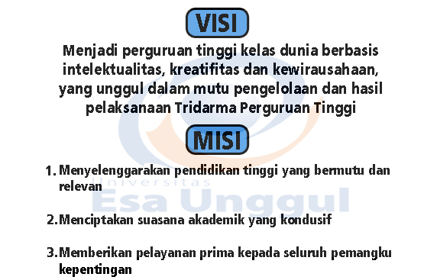
VISI DAN MISI UNIVERSITAS ESA UNGGUL

Slide 3
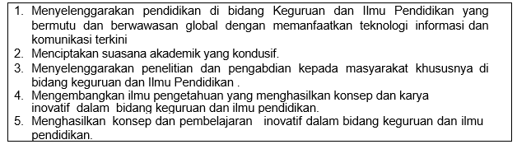
VISI FKIP
MISI FKIP

Slide 4
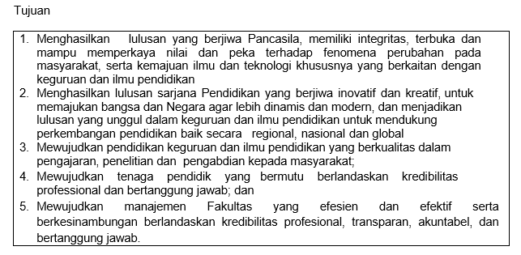
TUJUAN FKIP

Slide 6
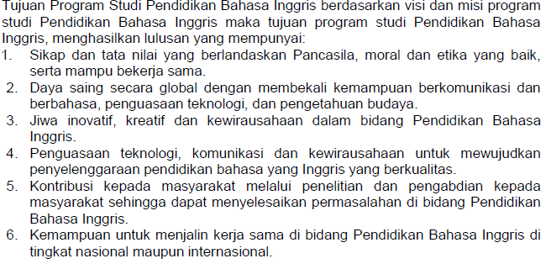

Slide 7
Learning Outcomes
Students are able to understand the conversation by using the gist and keyword.

Slide 8
Rules of the game
Come on time.
Submit assignment on time.
Do quizes.

Slide 9
Weekly individual assignment
Find a video with minimum duration is 60 minutes. Summarize the content of video in the form of PPT file. The minimum slides are 6 slides.
In each week, one of you will play the interesting part of the video (around 15 minutes).

Slide 10
Text 1
https://www.youtube.com/watch?v=-SsDV5qd5cw
How is Julia’s feeling?
What does Julia’s friends predict about her and Gary?

Slide 11
Text 2
What is Gray’s feeling when he knows the signature is for grandma?
What do they do in their work?
What is the problem and how is it solved?

Slide 12
Text 3
What’s the invitation about?
What’s parents’ plan for Sunday morning?
What’s surprising at the end of the story?

Slide 13
Text 4
What exercises did she do?
How does she feel at the gym?

Slide 14
Text 5
What makes Julia upset?
What makes Tim does not attend the dinner?

Slide 15
Text 6
What’s wrong with Tim?
What makes Julia does not focus?

Slide 16
Text 7
What did Tim think about Julia at the beginning?
What did Julia think about Tim at the beginning?

