Slide 1
INTERMEDIATE READING
FIRST MEETING
NONI AGUSTINA, M.Pd.
PENDIDIKAN BAHASA INGGRIS, FKIP

Slide 2
VISI DAN MISI UNIVERSITAS ESA UNGGUL

Slide 3
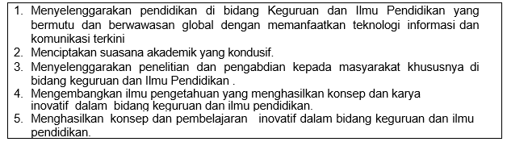
VISI FKIP
MISI FKIP

Slide 4
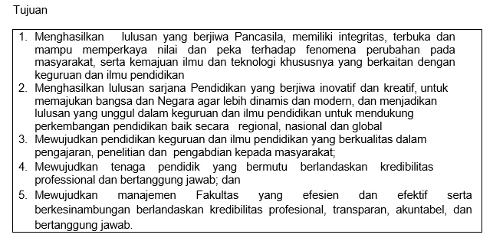
TUJUAN FKIP

Slide 7
Sessions before mid-term test
01. Introduction
02. Reading for pleasure
03. Main idea and supporting details
04. Scanning
05. Skimming
06. Guess meaning from the context
07. Pronoun and synonym

Slide 8
Sessions after midterm test
08. Predict the event
09. Positive and negative points
10. Comparison and contrast
11. Interpret the chart
12. Making inferences and draw conclusion
13. Paraphrasing
14. Make a short article

Slide 9
RULES OF THE GAMES
Try your best to speak English in the classroom
Come to the class on time
Bring the dictionary (digital or printed)
Submit assignment on time
Be honest

Slide 10
Assessment
Attendace 10%
Assignment 20% (Including the class participation)
Mid-term test 30%
Final test 40%

Slide 11
References
Kirn, Elaine and Pamela Hartmann. (2002) Interaction 2 Reading. Fourth Edition. NY: McGraw-Hill Contemporary
Langan, John. (1992). Reading and study skills. Fifth Edition. USA: McGraw-Hill Inc.
Mikulecky, Beatrice S. and Linda Jeffries. (1998). Reading power. Second edition. NY: Pearson Education.
Wegmann, Brenda and Miki Knezevic. (2002). Mosaic 1 Reading. Fourth edition. NY:McGraw-Hill Contemporary

