Slide 1
INTERMEDIATE WRITING
SESSION KE 12 BAR CHARTS
MEIYANTI NURCHAERANI S.S,.M.HUM
PENDIDIKAN BAHASA INGGRIS, FKIP

Slide 2
KEMAMPUAN AKHIR YANG DIHARAPKAN

Slide 3
What is a bar chart?
Bar charts are a type of graph that are used to display and compare the number, frequency or other measure (e.g. mean) for different discrete categories of data. In the example below, which shows the percentage of the British population who attended different types of cultural events during 1999-2000, the types of event are the discrete categories of data.
Bar charts are one of the most commonly used types of graph because they are simple to create and very easy to interpret. They are also a flexible chart type and there are several variations of the standard bar chart including horizontal bar charts, grouped or component charts, and stacked bar charts.

Slide 4
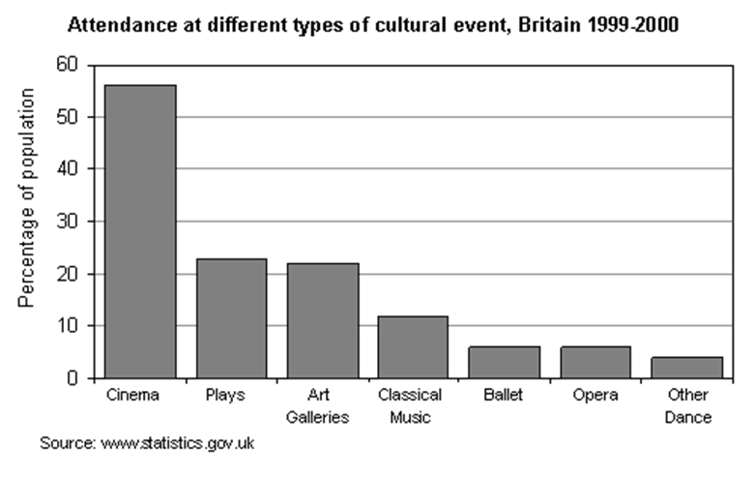
The chart is constructed such that the lengths of the different bars are proportional to the size of the category they represent. The x-axis represents the different categories and so has no scale. In order to emphasise the fact that the categories are discrete, a gap is left between the bars on the x-axis. The y-axis does have a scale and this indicates the units of measurement.

Slide 5
WHAT TYPES OF DATA CAN BE DISPLAYED USING A BAR CHART?
Bar charts are useful for displaying data that are classified into nominal or ordinal categories. Nominal data are categorised according to descriptive or qualitative information such as county of birth, or subject studied at university. Ordinal data are similar but the different categories can also be ranked, for example in a survey people may be asked to say whether they thought something was very poor, poor, fair, good or very good.
With nominal data, arranging the categories so that the bars grade sequentially from the largest category to the smallest category helps the reader to interpret the data. However, this is not appropriate for ordinal data because the categories already have an obvious sequence. Bar chars are also useful for displaying data that include categories with negative values, because it is possible to position the bars below and above the x-axis.

Slide 7
DIFFERENT TYPES OF BAR CHARTS
HORIZONTAL BAR CHARTS
Bar charts are normally drawn so that the bars are vertical which means that the taller the bar, the larger the category. However, it is also possible to draw bar charts so that the bars are horizontal which means that the longer the bar, the larger the category. This is a particularly effective way of presenting data when the different categories have long titles that would be difficult to include below a vertical bar, or when there are a large number of different categories and there is insufficient space to fit all the columns required for a vertical bar chart across the page.

Slide 8
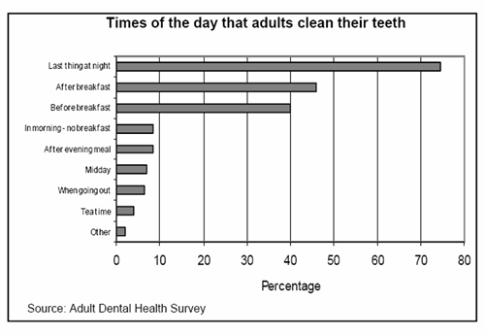
Note, that in Excel a chart in which the bars are presented vertically is referred to as a column chart, whilst a chart with horizontal bars is called a bar chart.

Slide 9
GROUPED BAR CHARTS
Grouped bar charts are a way of showing information about different sub-groups of the main categories. In the example below, a grouped bar chart is used to show the different schemes (sub-groups) by which different categories of household materials are recycled.
A separate bar represents each of the sub-groups (e.g. civic amenity sites) and these are usually coloured or shaded differently to distinguish between them. In such cases, a legend or key is usually provided to indicate what sub-group each of the shadings/colours represent. The legend can be placed in the plot area or may be located below the chart.

Slide 10
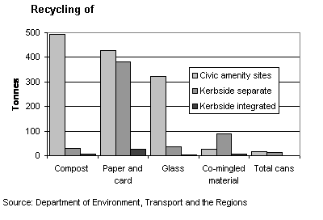
Grouped bar charts can be used
to show several sub-groups of each category but care needs to be taken to ensure that the chart does not contain too much information making it complicated to read and interpret. Grouped bar charts can be drawn as both horizontal or vertical charts depending upon the nature of the data to be presented.

Slide 11
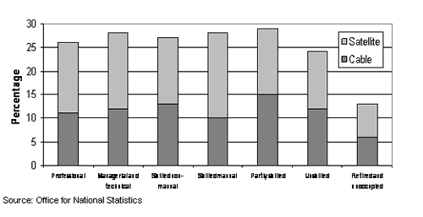
STACKED BAR CHARTS
Stacked bar chars are similar to grouped bar charts in that they are used to display information about the sub-groups that make up the different categories. In stacked bar charts the bars representing the sub-groups are placed on top of each other to make a single column, or side by side to make a single bar. The overall height or length of the bar shows the total size of the category whilst different colours or shadings are used to indicate the relative contribution of the different sub-groups.

Slide 12
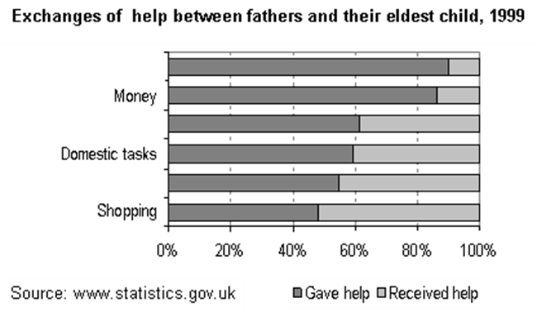
Stacked bar charts can also be used to show the percentage contribution different sub-groups contribute to each separate category. In this case the bars representing the individual categories are all the same size. The information could also be presented in a series of pie charts.

Slide 13
Where next?
This guide has outlined the various way in which bar charts can be used to present data and has also provided design and presentation advice. Information about other graph and chart types and any specific design issues related to them can be found in the companion study guides: Histograms and Pie charts. The study guide Presenting numerical data provides guidance on when to use graphs to present information and compares the uses of different graph and chart types.

Slide 14
THE BASICS OF BAR CHARTS
A bar chart looks a little like a picture of a skyline, consisting of different heights of ‘tower’ lined up side–by-side. The heights of the towers represent the relative sizes of the categories they represent. Some graphs show the towers on their sides, but you can deal with those by tilting your head or turning the paper through 90º.
Bar charts are made up of a series of rectangles – or bars – with each bar representing a different group. Each bar has the same width, but the heights vary to show the ‘value’ of each bar’s group – for example, how many people are in the group, or how much money comes from the group, or how many goals the team scored.

Slide 15
KNOWING WHEN TO USE A BAR CHART
You use a bar chart to compare the values of several numbers at once. The numbers could be measurements, amounts of money, numbers of people or things, all in different groups or categories. It lets you see at a glance which group is the most or least important.
You can also figure out the actual value of each bar by drawing a horizontal line across to the scale and reading off the number.
Bar charts are a little more honest than pie charts. The human brain is much better at assessing distance than it is area and angle, so people perceive bar charts more accurately than they do pie charts. Calculating the actual value of each group on a bar chart is also easier than on a pie chart.

Slide 16
You use bar charts and pie charts in similar situations – when you have several, separate values attached to separate categories. One situation where you definitely use a bar chart rather than a pie chart is when looking at the numbers as part of a whole doesn’t make sense.
Bar charts are better than line graphs when your data are in several distinct groups rather than over something measurable like time.
Good examples of when to use a bar graph are to compare the house prices in several different regions of the UK, to show the personal best race times of several sprinters, or to compare the heights of different species of tree.

Slide 17
SINGLE-BAR CHARTS (6 CHARTS AND GRAPHS FOR BASIC MATHS)
The simplest kind of bar chart is called, a little misleadingly, the single-bar chart. Any bar chart worth its salt has at least two bars in it, otherwise it’s not really comparing anything and you may as well just have written the number down. The word ‘single’ means that each category has only one number associated with it, so you get a single bar for each category.
Single-bar charts are by far the easiest type of bar chart to read and understand. To find out what a bar represents, here’s what you do:

Slide 18
Get a ruler (or anything with a straight edge) and lay it flat across the top of the bar, going sideways across the graph.
Make a small mark where the ruler crosses the vertical axis (the vertical numbered line).
If the mark lies on a value given on the scale, that’s the value of the category represented by the bar.
If the mark lies between two values, make an estimate of the number.
Think about whether the number’s halfway between the neighbouring values, or a little more or less.

Slide 20
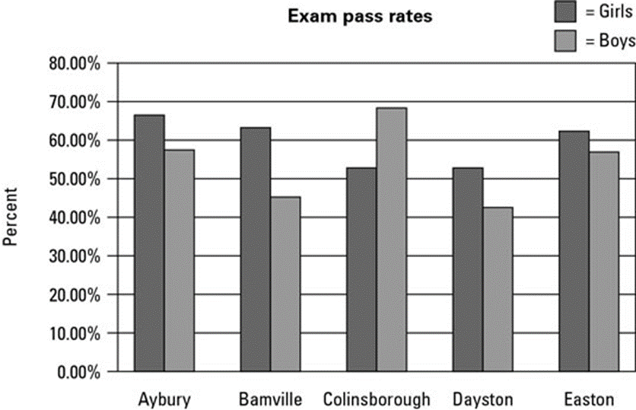
MULTIPLE-BAR CHARTS
More complicated – and sadly, more common in exams – are multiple-bar charts. You use multiple-bar charts to compare two different values across categories. For example, to investigate exam pass rates of several schools, you may want to compare the results of boys and girls. You then have two distinct bars in each category, coded with shading.

Slide 21
Another example is using a multiple-bar chart to compare average summer and winter temperatures in several cities.
Reading a multiple-bar chart is very similar to reading a single-bar chart. The only difference is that you need to make sure you look at the correct bar. Before you start, check the key – the little box that tells you which colour or type of shading corresponds to which subcategory – and then look at the bar in the correct category with the right colour or shading.

Slide 22
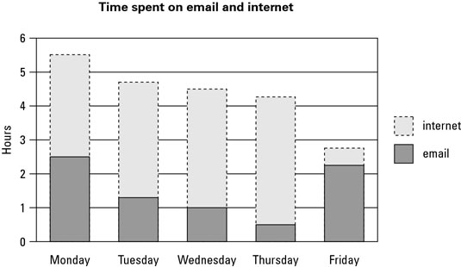
STACKED-BAR CHARTS
The purpose of these monstrosities is to show the changes in both the totals and the composition of a value – for instance, not only how your company’s income has changed but also how much of the income has come from each source.

Slide 23
Some of the information in a stacked-bar chart is pretty easy to read – you can figure out the total value and the value of the lowest bar using the same methods you use for normal bar charts. The values in the middle and at the top are a bit trickier. Here’s what you do:
Work out the value of the bottom of the bar you’re interested in by measuring across to the vertical axis, as you do with a regular bar chart.
Work out the value of the top of the bar you’re interested in, using the same technique.
Take the answer in Step 1 away from the answer in Step 2.
The result is the value of the bar.

Slide 24
REFERENCES
http://learnenglishteens.britishcouncil.org/sites/teens/files/b2w_writing_about_a_bar_chart.jpg
https://www.dummies.com/education/math/pre-algebra/the-basics-of-bar-charts/
https://www2.le.ac.uk/offices/ld/resources/numerical-data/bar-charts
http://www.bbc.co.uk/skillswise/factsheet/ma37grap-e3-f-reading-bar-charts

