Slide 1

INTERMEDIATE WRITING
SESSION 13 PIE CHART
MEIYANTI NURCHAERANI S.S.,M.HUM
PENDIDIKAN BAHASA INGGRIS FKIP

Slide 2

KEMAMPUAN AKHIR YANG DIHARAPKAN

Slide 3
Charts, tables and graphs present facts, which are objective and often involve measurement. For example, the bar chart on the right shows what a group of student think about a film they have just seen. We can interpret the information by saying that half the student did not like the film or by saying that fifty per cent of the student did not like the film. We can be even more specific and state that fifteen out off thirty student did not like the film.

Slide 4
1. Find out some factual information about your class members or your friends and family. How many of them enjoy taking part in the activities shown in the table below? Put a tick(√) against each activity the people like doing and then write the total in the total column
2. Use the information in the table to make a bar chart
3. Make some factual statements about the data. Try to use following structures
NUMBER Five out of ten
PER CENT Fifty per cent of people enjoy...
FRACTION A third of the

Slide 5
4. Now make some general observation using the same data. For example:
The most
The second most popular activity is....
The third most
The least
The majority of
A large number of
Most people enjoy....
Very few
Hardly any

Slide 6
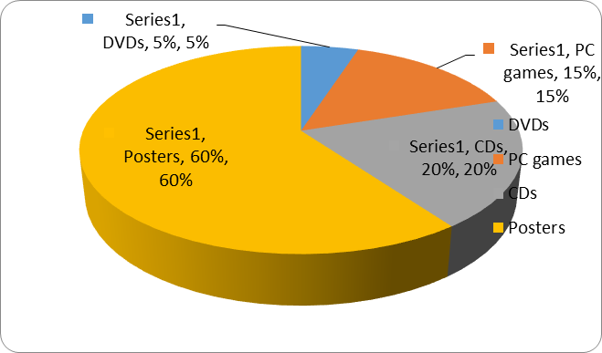
PIE CHARTS
A pie chart is another way of presenting information but the segments are always percentages of whole. Together they represent 100%.

Slide 7
5. Draw the bar chart on the previous page as a pie chart.
6. Read the test tip and the improve your writing box. Use the information in the pie chart of sales opposite to complete sentences 1-4 below.
Improve your writing
Make sure you know how to use per cent and percentage.
• Per cent comes after a number
• Percentage comes after words like the, a, this, that, etc. And is often preceded by an adjective, e.g. A high percentage of customers ...
• Both go with the preposition of.

Slide 8
Common error!
Nearly 30 percentage of the books were a new.
When writing number of percentage, use words up to the number ten, e.g. eight per cent, and then figures, e.g. 12 per cent. However, always write a number at the beginning of a sentence in words, e.g. Twelve per cent ...

Slide 9
1. According in the chart, ............................ of the shops sales are DVDs
2. Cd’s account for a much smaller .......................of sales
3. While PC games account for ........................... of the store’s sales,
4. Posters represent the ....................... of goods sold.

Slide 10
7. Draw a pie chart to show roughly what percentage of time you spend on the following activities in an average week: watching TV, working, studying, sleeping, using the internet, doing ‘other’ activities.
8. Swap charts with a partner and look at what he or she does in an average week, write some sentences that describe your partner’s chart.
Tables
Tables present information about different categories. Some times tables can be turned into charts but sometimes the categories are too different to do this

Slide 11
A number of secondary school in three countries conducted a survey about how their students travel to school. Here are the result.
Work with a partner. Together, discuss the similarities and differences in the table and then say whether you could turn this table into chart.

Slide 12
10. The sentences below describe the facts in the table in exercise 9. Complete the sentences using the information in the table and the words in the box.
11. Guess what the figures might be for your own country and add them to the table in exercise 9. Write some sentences comparing the figures with another country.
12. Work with a partner Together, discuss the questions.
a. Is the graph about people or vehicles?
b. What do the numbers along the horizontal axis represent?
c. What do the numbers on the vertical axis represent?

Slide 13
Improve your writing
Use the present perfect tense when you are describing a trend that began in the past and is still continuing
13. Write a short, overall statement about car ownership Britain.
14. Re-write your statement in two new sentences which include these words and phrases:
a. Since
b. Over a … period between 1960 and 2005
15. Now re-write your two sentences, a and b, to include the number of owners. You will have to re-organise your sentences to do this.

Slide 14
16. Work with a partner. Together, discuss the questions.
a. What does the process diagram below show?
b. What do the arrows represent?
c. What does the scale at the side of the diagram describe?
17. Complete this short description of the diagram by first choosing the most suitable verb from the box for each gap and then putting it in the correct form.
1. Describing trends
Overview is an overall summary of the information and is different from an introduction, which simply states what the diagram or chart shows. The examiner will expect to find an overview as part of your answer to Task 1.

Slide 15
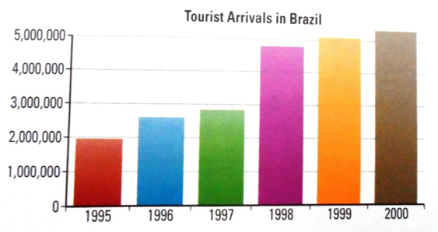
1. Look at the bar chart and say what information is being shown. Here are two descriptions of the overall trend shown in the bar chart.

Slide 16
2. Add considerably to the first sentence and considerable to the second sentence. What effect do these words have?
3. Re-write the two sentences about tourism in Brazil to include a reference to time and to the number of tourists in figures.
4. Look at the table below and say what information is being shown. Write two sentences which describe the information and provide an overview.

Slide 17
5. Look at these words and phrases which will help you describe trends

Slide 18
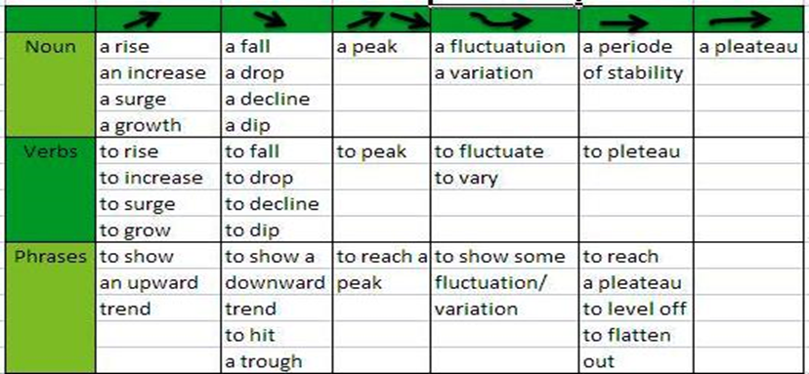
6. Using the nouns and adjectives from the table help you

Slide 20
7. Describe each trend again, this time using the verbs and adverbs from excercise 5. e.g. 1 It falls sharply.
8. Look at A-C which present different kinds of information about a large multinational company. Write three short paragraphs about the information. For each graph or chart, first write a sentence which describes what it shows. Then write another sentence which describes the trend you can see. Finally, write a sentence which includes some specific data.

Slide 21
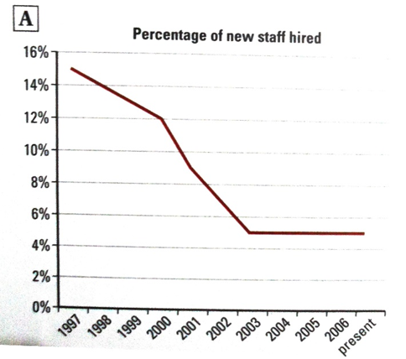

Slide 22
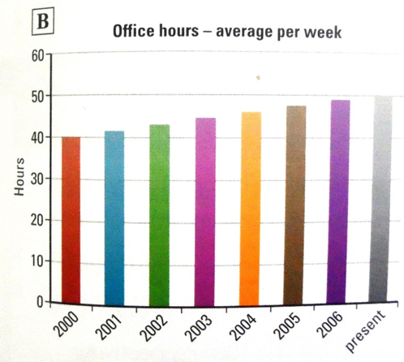

Slide 23
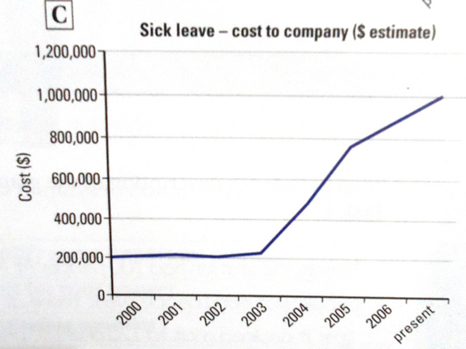

Slide 24
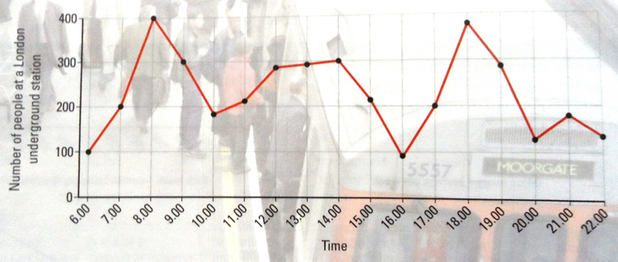
9. Look at the graph below and answer the questions.
a. What does the graph show?
b. How is the overall trend in this graph different form others you have looked at in this unit?
c. What tense will you use to describe it?

Slide 25
10. Write four or five sentences about the trends you can see in the graph of HARRY’S annual sales of hamburgers. Try to include the words stable, fewer, rise, sales, peak and drop.
11. Write general observation about the popularity of hamburgers over the year.
12. State, what is being shown in the graph below in your own words. Circle the most important trends.

Slide 27
13. Read a student’s description of the graph and the advice on how to approach Task 1
How to approach the task
• State the purpose of the graph or chart
• Provide an overview
• Select the key trends of features.
• Illustrate these with figures.
• Make a simple, relevant round-off point-if appropriate
14. Work with partner together discuss the description of the graph above. How successfully has the writer used the advice on how to approach Task 1

Slide 28
15. Take 20 minutes to write a better description of the graph in exercise 12 using the advice to help you. Then compare you answer with the model answer in the key.
16. Work with a partner and discuss which of the numbered and underlined parts of the model answer provide:
a. an introduction to the chart
b. the key trends
c. an overview of the trends.
17. Look the model answer in the key again and circle the words and phrases the writer uses to link the different points.

Slide 29
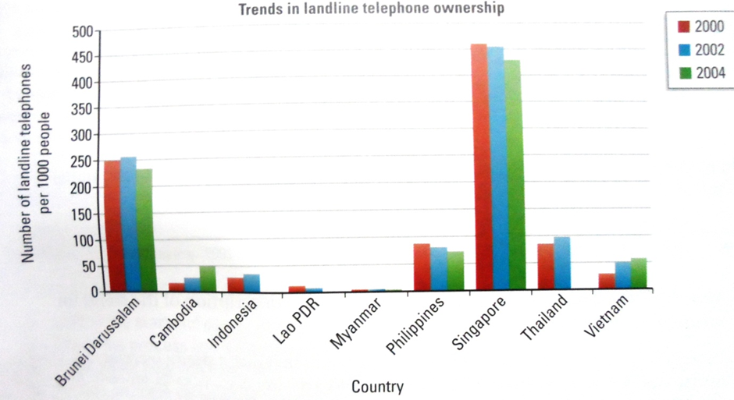
SUMMARIZING INFORMATION
1. Work with partner
2. Discuss what the chart shows and identify some important points.
3. Consider which tense you will use most for your answer.

Slide 30
4. Follow the instruction 1-6 to write a description of the chart
Write one sentence which states what the chart shows.
Write two sentence which give an overview of the chart
Write two sentences about Singapore.
Write one sentence about Brunei Darussalam.
Write one sentence about Cambodia and Vietnam.
Conclude with a final sentence about the remaining countries
5. Swap answer with a partner. Read you partner’s description of the chart and compare it with the model answer in the key.

Slide 31
6. Now look at your partner’s description and the model answer again and answer question 1-6 for both. Did your partner.
1. give you the overall time period in the first sentence?
2. use a suitable verb and adverb to describe the trend in the second and third sentences?
3. provide some figures for Singapore?
4. use fluctuate with an appropriate figure for Brunei Darussalam?
5. note a contrast in the trends?
6. get the figures correct overall?

Slide 32
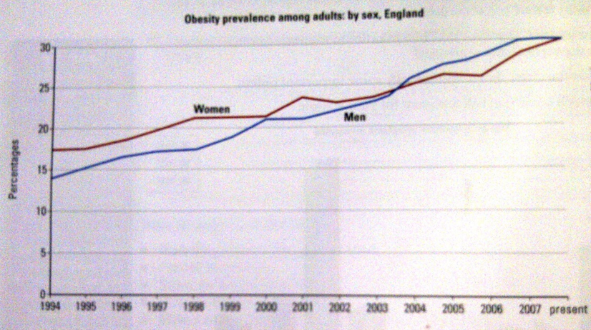
7. Underline the data in the first paragraph of this summary, which introduces the graph and provides an overview.

Slide 33
The graph shows how obesity levels have increased in England since 1994 clearly, figures have doubled over this period reaching a current high of around 30 percent for both male and female adults (34 words)
8. Use the information in the graph to complete this description of the trend for women.
Looking more closely at the trend for women it can be seen that a steady increase took place between 1994 and 1998, with obesity levels rising by 1 ……………………………….. to 21 per cent. This was followed by a 2 …………………………….. period of stability. Then after the year 2000, levels rose again, reaching a peak of 3 …………………………………. In 2001. Since then, apart from a slight fluctuation, the percentage of obese women in England has increased significantly. (77 words)

Slide 34
9. Draw two vertical line on the graph to show how the writer divided up the overall trend for women.
10. Divide the male trend into three parts by drawing two more vertical lines on the graph. Then write a paragraph about the male pattern and provide an overview summarising the trends. Count the number of words in your paragraph.
11. Look at the graph below and then write a summary of the main trends, using some of the structures from the answer to exercise 10. Remember to say that it shows and include an overview. Count your words at the end.

Slide 35
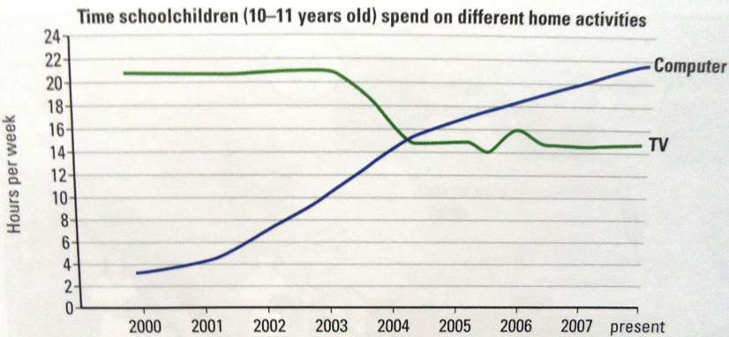

Slide 36
12. Work with a partner. Together, look at the task on the next page and then discuss these question
a. Can you rephrase the task introduction in your own words?
b. Which key words in the labels do you need to rephrase?
c. Which words could you try to rephrase?
d. What other vocabulary do you know that would be useful to describe the equipment or process?
e. What linking words might you use?

Slide 37
