Slide 1
ADVANCED READING
SESSION 1
DR. FEBRIYANTINA ISTIARA, M.PD
PENDIDIKAN BAHASA INGGRIS, FKIP

Slide 2
VISI DAN MISI UNIVERSITAS ESA UNGGUL

Slide 3
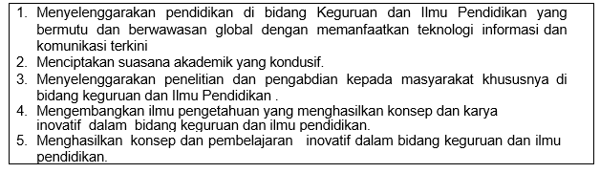
VISI FKIP
MISI FKIP

Slide 4
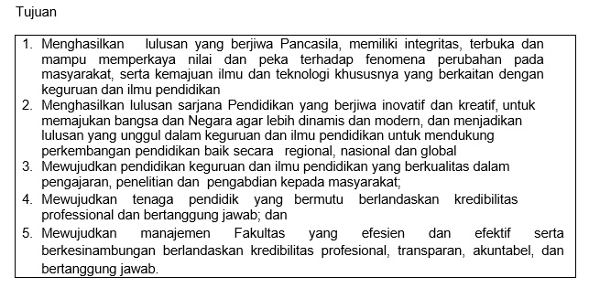
TUJUAN FKIP

Slide 7
Sessions before mideterm test
01. Introduction to course
02. Vocabulary and word attack Part 1
03. Vocabulary and word attack Part 2
04. Vocabulary and word attack Part 3
05. Main Idea and Diction
06. Detail an Inference
07. Review

Slide 8
Sessions after midterm test
08. MID TEST
09. Connotation
10. Tone
11. Form and logic
12. Distinguish effective
13. logical writing from poor writing
14. Review

Slide 9
RULES OF THE CLASS
Try your best to speak English in the classroom
Come to the class on time
Bring the dictionary (digital or printed)
Submit assignment on time
Do your project

Slide 10
LEARNING OUTCOME
Students are able to know advanced reading.

Slide 11
What is Reading Comprehension?
Reading comprehension skills separates the "passive" unskilled reader from the "active" readers.
Skilled readers don't just read, they interact with the text.

Slide 12
What is Critical Reading or Advanced Reading?
Reading critically does not, necessarily, mean being critical of what you read.
Both reading and thinking critically don’t mean being ‘critical’ about some idea, argument, or piece of writing - claiming that it is somehow faulty or flawed.

Slide 13
Critical reading means engaging in what you read by asking yourself questions such as, ‘what is the author trying to say?’ or ‘what is the main argument being presented?’

Slide 14
Benefits of Good Reading Comprehension
Reading comprehension skills increase the pleasure and effectiveness of reading.
Strong reading comprehension skills help in all the other subjects and in the personal and professional lives.
All the tests you take in elementary, middle, and high school are geared towards determining if you are at your reading grade level and/or college ready.

Slide 15
Important areas
Five critical reading skills were found to be very important for improvement:
Phonemic awareness
Phonics
Fluency
Vocabulary
Comprehension

Slide 16
Speed Reading
Develop "traditional" old fashioned speed reading habits first
Once thoroughly ingrained it will allow the student to input and scan information quickly
Reading becomes habitualized at mostly an unconscious level.
In this version of speed reading, rather than the incoming flow of information being the focus of attention, active cognitive processes that organize information dominate.

Slide 17
Mind Mapping
Basically going through information in order to find the major concepts
A student can create a visual Mind Map or a Linear Mind Map
Really helps for studying for tests in general

Slide 18
Chunking Reading
Basically highlighting chunked portions of the reading in order to read faster
Students practice reading the highlighted areas faster and faster until they reach the desired speed and comprehension levels

Slide 19
Vocabulary
Vocabulary is important to not only reading, but writing.
Studying and utilizing vocabulary helps reading comprehension

Slide 20
Thank you

