Slide 1
Distinguish effective logical writing from poor writing
SESSION 11
DR. FEBRIYANTINA ISTIARA, M.Pd
PENDIDIKAN BAHASA INGGRIS, FKIP

Slide 2
Why academic writing & library skills?
In today’s environment of rapidly changing health care and information technology, nurses require the key skills of information literacy & writing skills, to use and communicate information in an appropriate and effective manner.
Writing & information skills are an immensely important & powerful tool in the academic world.

Slide 3
Developing academic literacy
As a professional-crucial to write well.
Developing an awareness of the epistemology (theory of knowledge of subject).
Does not require unique talent/ outstanding ability.
Everyone has basic skills necessary to write well

Slide 4
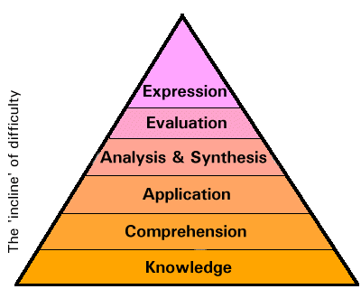
A pyramid of skills-Bloom’s Taxonomy(1956)

Slide 5
Writing clearly & persuasively
is a valuable skill
Descriptive: Portrayal of the
main features: “Describe…………..”
Analytical: Stating a point, providing evidence, contrasting this with other evidence, drawing logical conclusions. “Analyse and discuss…………”
Anecdotal: Personal experience of self/others.
Empirical/evidence-based: Scientifically verified & published.

Slide 6
Example Writing at 3rd level
Don’t make the mistake of thinking that
graduate level writing means using complex
English & long words.
e.g.’‘It is intuitive, therefore, that the fundamental
dichotomy in theory and practice is inevitably
exacerbated and irrevocably confounded by the
underlying quixotic nature of nursing lecturers’. no,no,no!
All you are saying, obtusely, is:
‘‘it seems obvious that the theory practice gap is
always going to be made worse, and become utterly
confused, by nursing lecturers who don’t live in the
real nursing world’.
Clear, simple writing is best!

Slide 7
Coherence
Must be logical - make sense.
You will be judged on coherence - if it is intelligible & ‘holds together’.
Put information down logically, so that the sentences connect together in a way that makes sense.
You should spend time rearranging the main points until they are in logical order.
Writing a paper is not only a matter of gathering and presenting information, it is an exercise in comprehension and critical analysis.

Slide 8
THANK YOU

