Slide 1
ADVANCED WRITING
SESSION 1
SRI LESTARI, S.Pd, M.A.
ENGLISH EDUCATION DEPT. FKIP

Slide 2
VISI DAN MISI UNIVERSITAS ESA UNGGUL

Slide 3
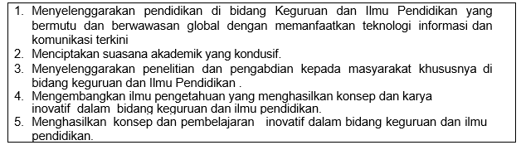
VISI FKIP
MISI FKIP

Slide 4
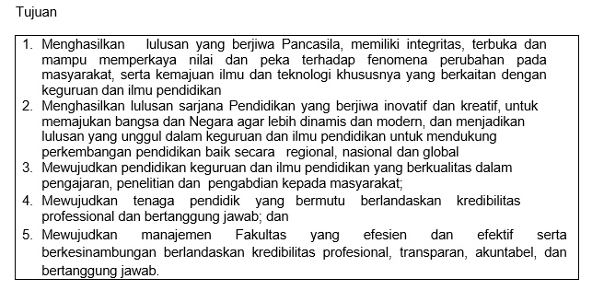
TUJUAN FKIP

Slide 7
LEARNING OBJECTIVE
This course aims at improving students’ writing skills in developing a research paper, thesis, and dissertation. In terms of low-level of a manuscript, it most frequently does not refer to the grammar or vocabulary issues but the readability. The factors supporting the readability will be examined in this course.
Students are able to compose a research proposal

Slide 8
COURSE OUTLINE
NO | Component | Description
1 | Subject name | Advance Writing
2 | Credits | 3
3 | Time allocation | 100 minutes
4 | Prerequisite | Basic Reading Comprehension
5 | Sessions | 14 (exclude Midterm and Final exam)
6 | Method | Discussion; Presentation;
7 | Assessment & Scoring | Attendance & Participation =10% Assignment & Formative = 30% Midterm Test = 30% Final Exam = 30%
8 | G-class Code | 64zhf3

Slide 9
Sessions before midterm test
01. Introduction to Academic Writing
02. Basic Concept of Academic Writing
03. Introduction to a research report
04. Planning your argument
05. Developing your arguments
06. Organizing introduction sections
07. Composing an introduction draft

Slide 10
Sessions after midterm test
08. Selecting relevant theories for a lit.rev
09. Summarizing & Synthesizing literature
10. Citation and Referencing
11. Organizing a literature review & Drafting
12. Structuring a methodology chapter
13. Editing, proofreading and lay outing
14. Presenting a research proposal

Slide 11
REFERENCES
Bowker, Natilene. (2007). Academic Writing: A Guide to Tertiary Level Writing. NZ: Student Learning Development Series of Massey University.
Wallwork, Adrian. (2013). English for Academic Research: Writing Exercises. New York: Springer.
Swales J M and Feak C B (2012) Academic Writing for Graduate Students, 3rd edition, University of Michigan Press. USA
Bailey, S.(2006). Academic Writing. A handbook for International Students. Oxon and New York: Routledge
Jordan, R.R.(1999). Academic Writing Course. Study Skills in English. Edinburgh: Pearson Education Limited.

Slide 12
CLASS REGULATION
Attendance: 15% late, more → absent
Permission: letter
Communication: in English, chatting etiquette; via phone and e-mail; Google classroom (see Code)
Manner that matters

Slide 13
DISCUSSION
What kind of writing do you know?
What are you hoping to gain from this course?
Write down two or three priority areas

