Slide 1
SESSION 10:
CITING, QUOTING, REFERENCING
SRI LESTARI, MA
ENGLISH EDUCATION DEPARTMENT

Slide 2
INTENDED LEARNING OUTCOMES
01. To avoid plagiarism
02.
To cite, quote and reference correctly and effectively

Slide 3
CITING, QUOTING, REFERENCING
The techniques of demonstrating evidence of your literature exploration by including these authors in your writing and mentioning their points of view

Slide 4
CITING
Convention for citing author or referencing system: APA, Harvard, MLA, Chicago
APA (American Psychological Association) → an author-date pattern for citing ; can be in the body of the sentence, or in brackets at the end of the sentence

Slide 5
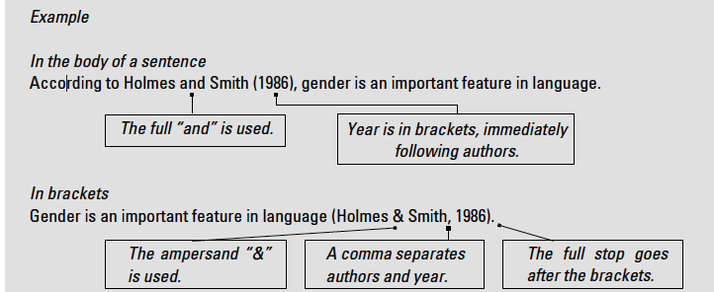
EXAMPLE
Sources: Natilene

Slide 6
VARIETY OF VERBS WHEN INTRODUCING AUTHORS
Anderson (2013) states …
McDonald(2018) says …
agree | define | describe
assert | examine | conclude
believe | focus on | compare
claim | maintain | suggest
highlight | mention | point out
summarize | observe | identify

Slide 7
CITING
If there are two or more authors with the same surname

Slide 8
CITING
If there are two or more publications written by the same author in the same year. Example:
McMillan (1992a) illustrates cross-cultural awareness in organizations, …
McMillan (1992b) argues for the significance of gender in …
When stating the same author twice in a single paragraph, the year only needs mentioning the first time in the paragraph. Example:
The notion of anger has been debated for centuries (Wilkinson, 1976). Indeed, Wilkinson points out that….

Slide 9
CITING
When citing a publication written by three to five authors, for the first text citation, include all names. On subsequent citations, state the first author followed by “et al.”, which is a Latin abbreviation for “et als”, meaning “and others”.
In the body of a sentence: According to Slater et al. (1978, p. 120), it is important to establish the grounds of the argument.
In brackets: It is important to establish the grounds of the argument (Slater et al. 1978, p. 120).

Slide 10
CITING
In the case of secondary citations, that is when a source you are using cites someone else’s work – which is the work you want to include, but you do not have access to the original document – it is important to acknowledge both the original source and the source you have access to. When documenting both sources in brackets, use “as cited in” before the secondary source. For example:
Riechter’s (1984, as cited in Smith, 2003) study highlights how business models offer a framework for understanding commercial mechanisms.

Slide 11
QUOTING
A quotation is an exact copy of the words that someone else has written or said. These words are placed within quotation marks “ ”, which are also referred to as speech marks.
In addition to documenting the author’s surname and year of publication, as with all citations of others’ work in accordance with APA referencing, you also need to include the page number where the quotation was located.

Slide 12
EXAMPLE

Slide 13
QUOTATION TIPS
Type the exact wording, spelling, and punctuation of the original source, including American spelling
If you need to remove details from a quotation, replace the words removed with three dots, referred to as ellipses. For example:
Jones (2001, p. 115) stated that “the ‘placebo effect’ … disappeared when all the relevant behaviors were studied.”

Slide 14
QUOTATION TIPS
For quotations of 40 or more words, indent the whole quotation (by about 5 spaces) as a block of text, and remove the quotation marks. For example:

Slide 15
QUOTATION TIPS
For secondary quotations, or quotations that are cited in another source, providing that the original is not available, both sources must be mentioned. When documenting both sources in brackets, use “as cited in” before the secondary source.

Slide 16
REFERENCING
a detailed list of these sources at the end of your assignment.
If you are using APA conventions, then this is referred to as a Reference List and is headed up References.
In some disciplines, you may also be asked to include a Bibliography, which is a list of sources you used to develop ideas around the assignment topic, but which you did not actually cite or include in the body of your assignment

Slide 17
FORMATTING THE REFERENCE LIST
References are in alphabetical order according to the first author’s surname.
With two or more publications by the same author, list the earliest dated publication first.
The second line of each reference (and thereafter) is indented by about 5 spaces. This can be formatted automatically by using the “Hanging” feature under “Indentation” within the “Indents and Spacing” section within the “Paragraph” option of the “Format” column of the menu bar, found in most Microsoft Word programmes.

Slide 18
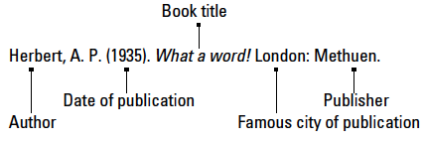
DETAILS IN REFERENCE LIST
Referencing a book
Referencing a chapter within an edited book

Slide 19
DETAILS IN REFERENCE LIST
Referencing a chapter within an edited book

Slide 20
Referencing a journal article

Slide 21
REFERENCES
Bowker, Natilene. (2007). Academic Writing: A Guide to Tertiary Level Writing. NZ: Student Learning Development Series of Massey University.
UCL Institute of Education (2016) Writing Centre Online [Online] Available at: https://www.ucl.ac.uk/ioe-writing-centre (last accessed on 20 May 2019)

