Slide 1
SESSION 2
BASIC CONCEPT OF ACADEMIC WRITING
SRI LESTARI, MA
ENGLISH EDUCATION DEPARTMENT

Slide 2
What to discuss:
01. What is academic writing?
02. What is genre?
03. Which genres are academic?
04. What are the characteristics of academic writing?

Slide 3
ACADEMIC GENRE
Which of the following genres are academic?
A critical review
A journal article
A novel
A text message
Research report
Dissertation/thesis
Application letter
A Research Proposal
Literature review
Essay

Slide 4
DISCUSS with a person next to you …
Which academic writing genres are you familiar with?
Are there any types or genres you are unfamiliar with?
Based on the academic genres, discuss the following questions
1. How is the text structured / organised?
2. Why is the text structured / organised in this way?
3. What is the purpose of each text?
4. Who is the audience for each text?
5. What style of writing is used in each text?
6. Are distinctions between different texts always clear or sometimes blurred?

Slide 5
What is genre?
Genres:
‘serve the situations in which they arise’ (23)
‘represent certain recognizable occasions’ (23)
are ‘connected to social contexts where people do things: like selling a house or finding a mate’ (24) or passing a course
are ‘not universal but cultural’ (25)
'Introducing Genre' (Giltrow, 2002)

Slide 6
EXERCISE
Read the extracts in your handout
Discuss to answer the questions below:
What kind of source do you think each text comes from? How do you know? What is the purpose of each? What audience is each aimed at?
Which extracts are from ‘academic’ texts? What features of the writing distinguishes them from the ‘other’ text(s)? Consider vocabulary/terms, register (formal/informal, etc.), sentence structure and length, length of paragraphs, linking of paragraphs, use of evidence/sources, geographical/temporal precision of contexts referred to.
How can the ‘non-academic’ text be made more ‘academic’ and can some of the phrasing of the ‘non-academic’ texts be used in academic texts?
Are there any features of the text(s) you’ve identified as ‘academic’ that align them with non-academic writing?
Why do you think I have placed the word ‘academic’ in quotation marks? When are quotation marks used in academic writing?

Slide 7
CHARACTERISTICS OF ACADEMIC WRITING
ACADEMIC WRITING
- well-organized → structure: introduction, discussion, conclusion
- Citation of published author
- Grammatical complexity → Rules of punctuation and grammar
- Focus on abstract things like idea, concept, theories
- Vocabulary choice → academic
- Caution/Hedging → not to make claims that are too strong (use ‘may’ or ‘might’)
- Impersonality → write in the 3rd person, not ‘I’ or ‘you’, except for reflective writing
- Conciseness → word counts; avoid repetition in ideas; use few words/alternative words
- Precision → formality; use the terms correctly
- Relevance → demonstrate critical understanding; relevant to questions; avoid unnecessary descriptive details
- Objectivity → not personal; emphasize on information; use noun and adjective

Slide 8
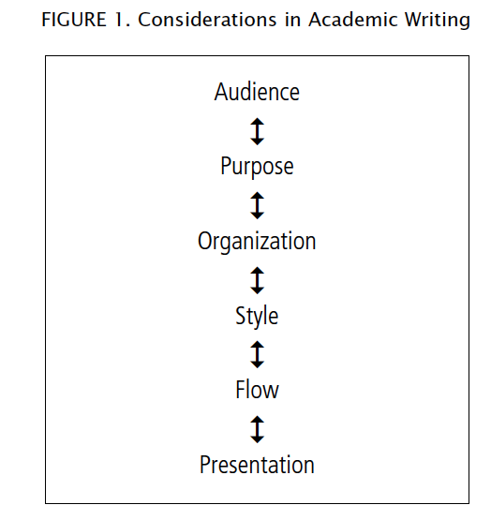
CONSIDERATIONS IN ACADEMIC WRITING

Slide 9
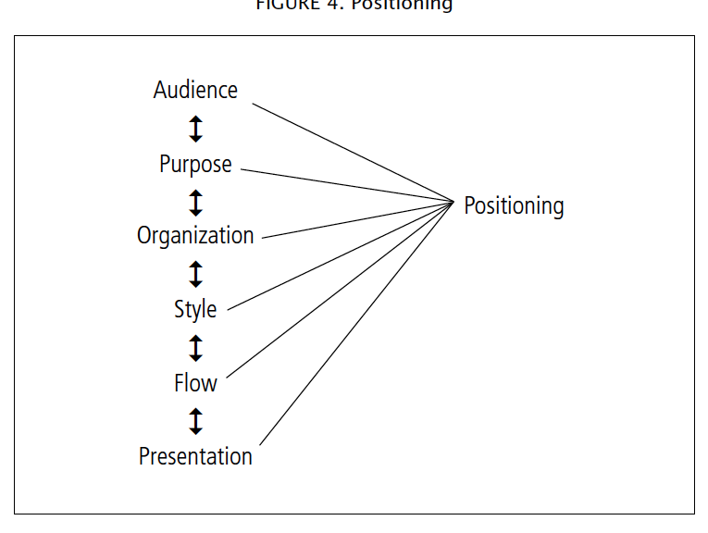

Slide 10
AUDIENCE → who are intended to read your writing
PURPOSE → why are you writing it?
ORGANIZATION → how is it organised?
STYLE → how is it written?
FLOW → moving from one statement in a text to a next
PRESENTATION → how is it presented (min. errors)

Slide 11
PURPOSE
The purpose of academic writing effects:
The content: the ideas you write
The format : the lay out of your writing
The style or language used: how formal and informal you are

Slide 12
REFERENCES
Bowker, Natilene. (2007). Academic Writing: A Guide to Tertiary Level Writing. NZ: Student Learning Development Series of Massey University.
Giltrow, J. (2002) Academic Writing: Writing and Reading in the Disciplines. 3rd ed. Ormskirk: Broadview press.
Swales J M and Feak C B (2004) Academic Writing for Graduate Students, 2nd edition, University of Michigan Press. USA
Wallwork, Adrian. (2013). English for Academic Research: Writing Exercises. New York: Springer.

