Slide 1
SESSION 4:
HOW TO BEGIN AN INTRODUCTION
SRI LESTARI, MA
ENGLISH EDUCATION DEPARTMENT

Slide 2
INTENDED LEARNING OUTCOMES
01. To structure the introduction paragraphs
02.
To begin writing an introduction section

Slide 3
INTRODUCTION
Introduction section is to:
Tell your readers how you plan to develop your topic.
Give them a roadmap to follow- show them what your line of argument is.

Slide 4
HOW TO BEGIN AN INTRODUCTION
Begin with one or more of the following parts:
Definitions of the topic plus background (1-3)
Accepted state of the art plus problem to be solved (2-4)* → specific area; gap
Author’s objective (1-2)* → how to fill the gap, transition into the lit rev
Introduction to the literature

Slide 5
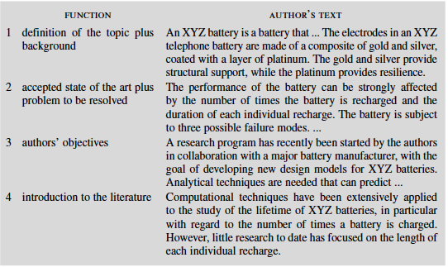
AN EXAMPLE OF INTRODUCTION STRUCTURE

Slide 6
HOW TO BEGIN AN INTRODUCTION (2)
Continue the previous outline:
Survey of pertinent literature
Author’s contribution (1-2)*
Aim of the present work (1-2)
Main result of the present work (1-4)
Future implication of the work (1-2)
Outline of structure (3-4)

Slide 7
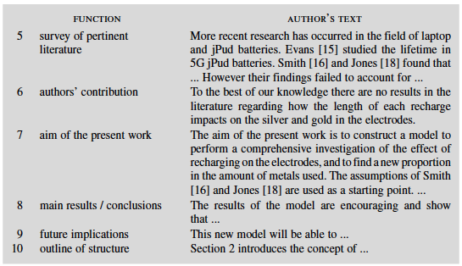
(Wallwork, 2013: 198-199)

Slide 8
HOW TO BEGIN AN INTRODUCTION (3)
General to Specific or Specific to General:
Opening with General Statement → general information; general – specifics
Opening with Statistics → generate readers’ interest
Opening with definitions → clarify unfamiliar terms

Slide 9
TENSES IN INTRODUCTION SECTION
PRESENT SIMPLE
To describe the general background context
Phonology is ….
PRESENT PERFERCT
Show how the problem has been approached
Phonology has been…
FUTURE TENSE
To talk about claim/conclusion

Slide 10
EXERCISE
Write an example of opening an introduction section using the structure of typical introduction in the table (number 1-4)
Continue to write the rest of introduction section using table number 5-10

Slide 11
REFERENCES
Bowker, Natilene. (2007). Academic Writing: A Guide to Tertiary Level Writing. NZ: Student Learning Development Series of Massey University.
Wallwork, Adrian. (2013). English for Academic Research: Writing Exercises. New York: Springer.
Swales, J.M & Feak, C.B. (2012). Academic Writing for Graduates Students. Michigan: Michigan ELT

