Slide 1
SESSION 5:
INTRODUCTION: DEVELOPING PARAGRAPHS
SRI LESTARI, MA
ENGLISH EDUCATION DEPARTMENT

Slide 2
INTENDED LEARNING OUTCOMES
01. To develop opening paragraphs
02.
To begin writing an introduction section

Slide 3
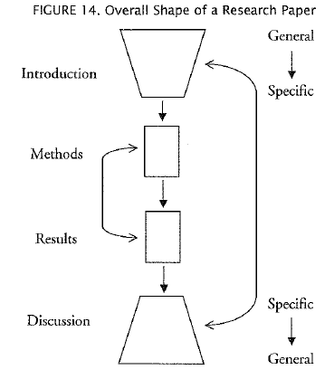
GENERAL TO SPECIFIC (GS)

Slide 4
OPENING WITH GENERAL STATEMENT
General statement can include those providing facts as well as broad statements made about a topic that are usually, but not necessarily always, true.
For example:
Medical tourism is growing in countries such as Thailand, Malaysia, and the Philippines
In the last decade, tremendous strides have been made in the science and technology of organic light-emitting diodes (OLEOs).

Slide 5
OPENING WITH GENERAL STATEMENT
Generalizations can be an effective opening sentences → familiar to the readers
Provide support explanations → helps move the passage from general to specific

Slide 6
OPENING WITH STATISTICS
Statistics can be particularly effective openings to GS texts because they can sometimes generate reader interest in the text.
For example:
In the United States in 2006, 4,784 pedestrians were killed in traffic accidents

Slide 7
OPENING WITH DEFINITION
Definitions are a common way of getting started; they are "hooks" from which GS paragraphs can be hung.
A definition sets the boundaries for a word's meaning.
Meanings may differ within some fields of study
Definitions of the concept differ for different research purposes and it may be necessary to clearly state the definition so as to avoid misunderstanding or criticism

Slide 8
OPENING WITH DEFINITION
Use a definition of a term or concept if one or more of the following apply:
1. the term Of concept is perhaps unfamiliar to your readers
2. you need to display your understanding for a course paper or examination
3. the origin of the term is interesting or sheds light on the meaning (as in our definition of definition earlier)
4. there is a lack of agreement on at some ambiguity surrounding the meaning.

Slide 9
OPENING WITH DEFINITION
Common ways to define:
short definitions or "glosses" that give information about a term in a word or phrase and are placed within either parentheses or commas in a sentence; phrasal definitions signaled by such devices as i.e. or phrases such as known as, defined as, and called
sentence definitions, which are brief and somewhat similar to a dictionary definition
extended definitions, which are longer and more detailed than definitions found in dictionaries

Slide 10
OPENING WITH DEFINITION
Some verbs to explain terms:
name → This new species was named Ascochyta.
denote → Any rotational velocity is usually denoted by f.
call → A book containing lists of word definitions is called a dictionary.
known as → Another principle source of heat is the natural increase in temperature as the depth increases. This is known as the geothermal gradient.

Slide 11
OPENING WITH DEFINITION
Some verbs to explain terms:
define → For the purposes of this study, fast food is defined as food sold by a franchised restaurant chain offering both dining and take-out facilities with no "table" service (e.g., McDonald's).
refer to → The natural gas contained in coal formations is generally referred to as coal bed methane.

Slide 12
EXERCISE
Write an example of opening an introduction with generalization (general statement), statistics and definition
You may refer to your previous works on a structure of typical introduction

Slide 13
REFERENCES
Bowker, Natilene. (2007). Academic Writing: A Guide to Tertiary Level Writing. NZ: Student Learning Development Series of Massey University.
Wallwork, Adrian. (2013). English for Academic Research: Writing Exercises. New York: Springer.
Swales, J.M & Feak, C.B. (2012). Academic Writing for Graduates Students. Michigan: Michigan ELT

