Slide 1
POETIC STUDY
SESSION 1
ROSALINA NUGRAHENI WULAN PURNAMI., M.Pd.
PENDIDIKAN BAHASA INGGRIS, FKIP

Slide 2
VISI DAN MISI UNIVERSITAS ESA UNGGUL

Slide 3
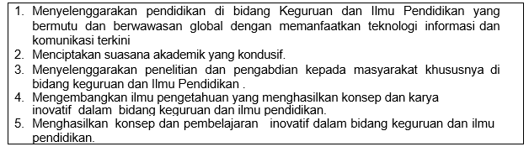
VISI FKIP
MISI FKIP

Slide 4
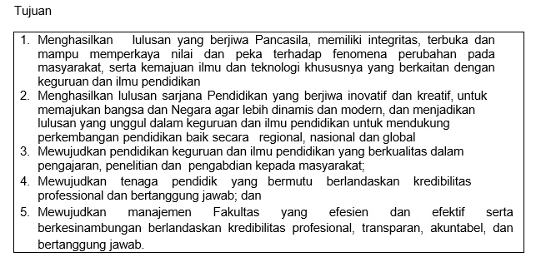
TUJUAN FKIP

Slide 7
Sessions before midterm test
01. Basic Theory & History of Poetry
02. Elements of Poetry: Intrinsic
03. Elements of Poetry: Extrinsic
04. Genre/Form of Poetry: Lyric , Narrative
05. Genre/Form of Poetry: Descriptive, Monologue
06. Stanza Types of Poetry
07. Poem Analysis

Slide 8
Sessions after midterm test
08. Sound Devices: Rhythm & Meter
09. Sound Devices:Word sounds & Word Devices
10. Meaning Devices : Denotative & Connotative
11. Sense Devices
12. Ways to Write Poetry
13. Poem Analysis
14. Poem Writing

Slide 9
LEARNING OUTCOME
Students explain what they are going to do and learn in the course
Students are able to elaborate and identify the basic theory and history of poetry

Slide 11
REFERENCES
Martiny, Eril. 2012. A Companion to: Poetic Genre. UK: Wiley-Blackwell
Hunley, Tom C. 2007. Teaching Poetry Writing: A Five-canon Approach. UK: Multilingual Matters Ltd
Lennard, John. 2006. The Handbook of Poetry. UK: Oxford University Press.

Slide 12
What is POETRY?
Poetry:
derives from a variant of the Greek term, poiesis = making (Wikipedia)
Poem:
comes from Greek word poema which means to create
Samuel Taylor Coleridge defined poetry as:
"the art of apprehending and interpreting ideas by the faculty of imagination; the art of idealizing in thought and in expression. For poetry is the blossom and the fragrance of all human knowledge, human thoughts, human passions, emotions, language."

Slide 13
William Wordsworth defined poetry as "the spontaneous overflow of powerful feelings,"
Emily Dickinson said, "If I read a book and it makes my body so cold no fire ever can warm me, I know that is poetry."
Dylan Thomas defined poetry this way: "Poetry is what makes me laugh or cry or yawn, what makes my toenails twinkle, what makes me want to do this or that or nothing."

Slide 14
What is POETRY?
“The best words in the best order” Samuel Taylor
“ The records of the best and happiest moments of the best and happiest minds” Percy Bysshe Shelley
“The spontaneous overflow of powerful feelings” William Wordsworth

Slide 15
Success is counted sweetest (112)
BY EMILY DICKINSON
Success is counted sweetest
By those who ne'er succeed.
To comprehend a nectar
Requires sorest need.
Not one of all the purple Host
Who took the Flag today
Can tell the definition
So clear of victory
As he defeated – dying –
On whose forbidden ear
The distant strains of triumph
Burst agonized and clear!
Source: The Poems of Emily Dickinson Edited by R. W. Franklin (Harvard University Press, 1999)

Slide 16
What is your definition?

Slide 17
WHY DO WE LEARN POETRY?
Poetry is language from the heart, the language used to see, hear, feel, smell, and taste the world.
Poetry allow us to experiment with words using different writing tools.
Poetry gives us an outlet for expressing our own interpretations of the owrld and helps us discover the power and importance of our own words.
By studying poetry, we are able to better understand other people, their perspective, and the world.

Slide 18
History: Poetry as an Art
Poetry as an art form predates literacy.
Some of the earliest poetry is believed to have been orally recited or sung.
Following the development of writing, poetry has since developed into increasingly structured forms, though much poetry since the late 20th century has moved away from traditional forms towards the more vaguely defined free verse and prose poem formats.

Slide 19
History: Poetry as an Art
Poetry was employed as a way of remembering oral history, story (epic poetry), genealogy, and law. It is often closely related to musical traditions, and much of it can be attributed to religious movements. Many of the poems surviving from the ancient world are a form of recorded cultural information about the people of the past, and their poems are prayers or stories about religious subject matter, histories about their politics and wars, and the important organizing myths of their societies.
Poetry as an art form may predate literacy. Thus many ancient works, from the Vedas (1700 - 1200 BC) to the Odyssey (800 - 675 BC), appear to have been composed in poetic form to aid memorization and oral transmission, in prehistoric and ancient societies. Poetry appears among the earliest records of most literate cultures, with poetic fragments found on early monoliths, runestones and stelae.

Slide 20
History: Poetry as an Art
The oldest surviving poem is the Tale of the Shipwrecked Sailor, written in Hieratic and ascribed a date around 4500 B.C.E.
Other sources ascribe the earliest written poetry to the Epic of Gilgamesh written in cuneiform; however, it is most likely that The Tale of the Shipwrecked Sailor predates Gilgamesh by half a millennium.
The oldest epic poetry besides the Epic of Gilgamesh are the Greek epics Iliad and Odyssey and the Indian Sanskrit epics Ramayana and Mahabharata.
The longest epic poems ever written were the Mahabharata and the Tibetan Epic of King Gesar.

Slide 21
Assignment
Find a poem of your interest
Bring them next session

