Slide 1
POETIC STUDY
SESSION 11
ROSALINA NUGRAHENI WULAN PURNAMI., M.Pd.
PENDIDIKAN BAHASA INGGRIS, FKIP

Slide 2
Genre/Form of Poetry:
MEANING DEVICES

Slide 3
LEARNING OUTCOME
Students are able to classify the meaning devices of poetry:
Denotative/Literal
Connotative/Figurative

Slide 4
There are often two types of meaning in poems:
Denotative (literal) and Figurative.
The Denotative (literal) meaning of a poem is what actually happens in the poem, on a purely superficial level. When you look at the literal meaning, it’s like you are trying to summarize the events/actions that take place in the poem. You should consider the denotation of words, the dictionary definition or most specific or direct meaning of a word.

Slide 5
The figurative meaning is generally associated with the theme, and is usually more abstract (i.e., a concept rather than a concrete physical description). It is the meaning behind the action.
2

Slide 6
A simple example of denotation (literal) vs. connotation (figurative) is considering the words slim and gaunt.
Both of these words’ literal meaning or denotation refer to being “thin” or “slender.” However, we wouldn’t use these words interchangeably because these words each have different connotations.
Slim in referring to body type is a positive word that implies a healthy thin girth, or being of a delicate or slender build.
Gaunt on the other hand implies being bony, like suffering from starvation or disease.
So when examining the poet’s diction, consider the connotation of the words used and why the poet might have chosen these specific words. But first you need to have a “literal” understanding of what the poem means simply based on what words are used. This means you understand the dictionary letter meaning of the words, “denotation,” and then you distinguish the “connotation” of the word so that you can analyze what the poem is really about (i.e. in a “figurative” sense).
words.

Slide 7
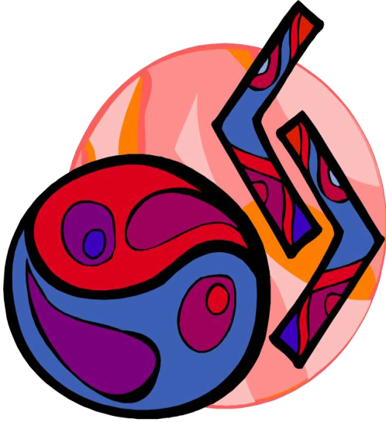
Simile,
Metaphor,
Personification
Symbol

Slide 8
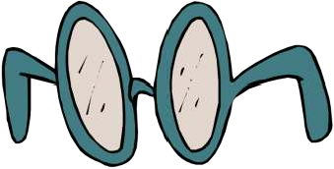
Figurative language is more than just a set
of clever devices used for writing
poetry, but it is one of the ways that we
understand our world.
From the time we were young children, we
began understanding the world by looking
for similarities between different things.

Slide 9
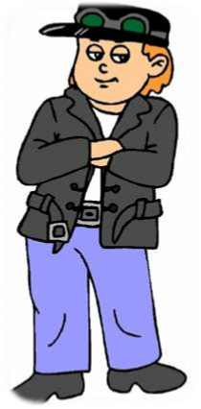
A simile is a figurative term that
compares two unlike things usually
using “like” or “as.

Slide 10
Some Examples:
•“Cool as a cucumber”
•“Smart as a whip”
•“He sticks to you like glue.
”
•“He swims like a fish.
”

Slide 11
A metaphor compares two unlike
things, saying that they are alike. It does
not use “like” or “as” but say that one
thing is the other thing.

Slide 12
Some Examples from
Shakespeare:
“All the world’s a stage,
And all the men and women
merely players;”
--from As You Like It
“Life is a tale told by an idiot.”
--from Macbeth

Slide 13
Personification gives objects or animals
human traits, behaviors, or emotions, or
otherwise portrays them as human.

Slide 14
Examples of Personification:
•“Father Time”
•“Mother Earth”
•“Cruel Fate”
•“Lady Luck”
•“The long arm of the law”
•“The whisperingwind”

Slide 15
Symbols are literal
(present, tangible, material) objects which carry figurative meanings.

Slide 16
Examples of Symbols:
•The American Flag (which symbolizes the
United States)
•Corporate Logos such as the swoosh (which
symbolizes the Nike Corporation)
•Religious Symbols, such as a cross, a star of
David, or a crescent moon (symbolizing
Christianity, Judaism and Islam)
•School Mascots

Slide 17
Here are a couple quick examples, beginning with an excerpt from Robert Frost’s famous The Road Not Taken:
Two roads diverged in a yellow wood, And sorry I could not travel both And be one traveler, long I stood And looked down one as far as I could To where it bent in the undergrowth…

Slide 18
So, what’s the literal meaning of the poem?
Our speaker has come to a fork in a path in the woods. It's fall, and the leaves are turning colors. He's unsure which way to go, and wishes he could go both ways. He looks down one path as far as he can see, but then he decides to take the other. He thinks the path he decides to take is not quite as worn as the other one, but really, the paths are about the same, and the fallen leaves on both look pretty fresh.

Slide 19
Figurative meaning.
These lines from the first stanza of the poem set the scene for the literal and metaphorical fork in the road that the speaker faces.
The road splitting in the woods is a metaphor for a choice. Wherever the speaker's life has taken him so far, he has come to the point where, to go any farther, he needs to make a choice that takes him down one path and precludes him from taking the other. Because the fork in the road is a metaphor for choices throughout the poem, it's called an extended metaphor.
This description of the road is a metaphor for the future. Just like we can only see a path in the woods for so far, we can only see the consequences of our decisions for a short while into our future.

