Slide 1
POETIC STUDY
SESSION 12
ROSALINA NUGRAHENI WULAN PURNAMI., M.Pd.
PENDIDIKAN BAHASA INGGRIS, FKIP

Slide 2
Genre/Form of Poetry:
SENSE DEVICES

Slide 3
LEARNING OUTCOME
Students are able to classify the sense devices in a poem.

Slide 4
Imagery
Is the literary term used for language and description that appeals to our five
senses. When a writer attempts to
describe something so that it appeals
to our sense of smell, sight, taste,
touch, or hearing; he/she has
used imagery.

Slide 5
What are the five senses?
The responsible system in the body for the five senses is the nervous system.
These senses make the body react.
These sense intensify an experience.
It makes reading more relatable and more vivid to the readers.
It helps characterize and desribe.

Slide 6
Imagery
It requires a lot of vivid descriptions.
It helps writing become clear and vivid.
It helps set the mood and the emotion about people, places, and circumstances.

Slide 7
Sensory Impressions
Are what you call vivid or clear descriptions.
These impressions should appeal to the five senses that all humans have.
These impressions will help your readers relate with you from any experience that you personally had.
2

Slide 8
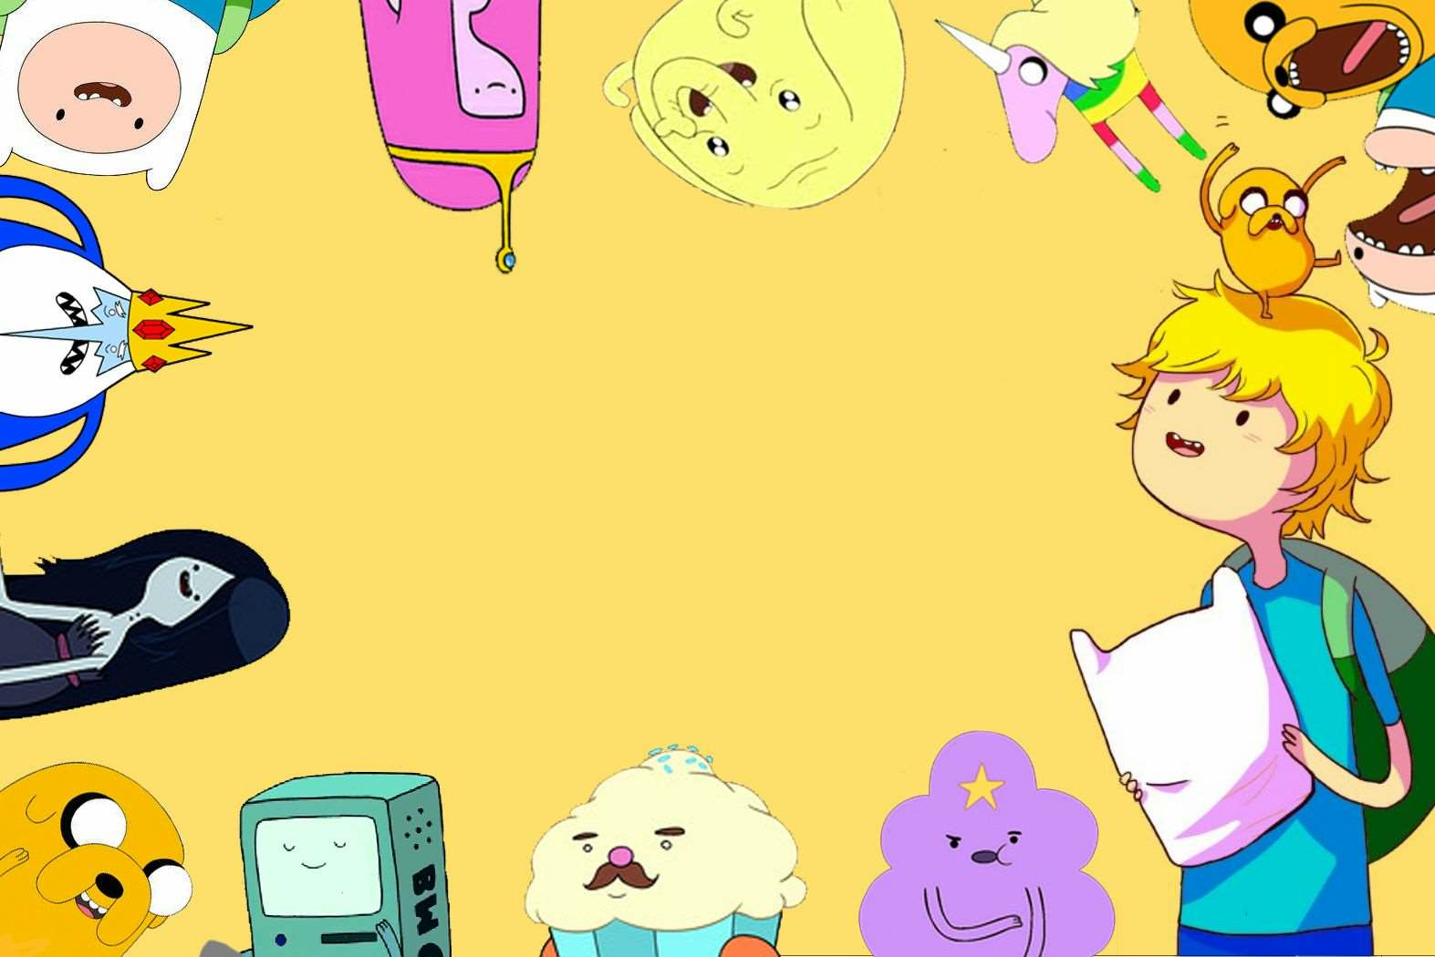
KINDS OF IMAGERY

Slide 9
Visual
words.
is a picture in words; something
that is concrete and can be seen.

Slide 10
“I see swimming pools and
living rooms and aeroplanes. I
see an empty house on a hill and
children's names”
-
Fools by Troye Sivan

Slide 11
Auditory
is something that you can hear
through your mind's ears.

Slide 12
“And rain falls angry on the tin roof
As we lay awake in my bed”
-
I'll Be by Edwin McCain

Slide 13
OLFACTORY
is something that you can smell
through your mind's nose.

Slide 14
“Mouth-watering ripe mangoes,
tender melons and luscious
cherries are served on tray”

Slide 15
Tactile
is something that you can touch
with your mind's skin.

Slide 16
“Just wanna feel your kiss
against my lips”
-
I Hate U, I Love You
by Gnash

Slide 17
Thermal
Something that depicts temperature

Slide 18
“There were nights when the wind was so cold..
There were days when the sun was so cruel”
-
It's
All Coming Back to Me Now
by Celine Dion

Slide 19
Erotic
Is something that suggest sensation and feelings from abstract ideas

Slide 20
“You can be the butterflies I feel
in my belly... You can be the chills
that I feel on our first date”
-
Perfect Two by Auburn

