Slide 1
POETIC STUDY
SESSION 13
ROSALINA NUGRAHENI WULAN PURNAMI., M.Pd.
PENDIDIKAN BAHASA INGGRIS, FKIP

Slide 2
Genre/Form of Poetry:
Ways to Write Poems

Slide 3
LEARNING OUTCOME
Students are able to elaborate ways to write poems.

Slide 4
Tips #1
Do Writing Exercises.
You can find inspiration for your poem by doing writing exercises and using the world around you. Once you have inspiration, you can then shape and mold your thoughts into a poem.
Brainstorming for Ideas Try a free write. Grab a notebook or your computer and just start writing—about your day, your feelings, or how you don’t know what to write about. Let your mind wander for 5-10 minutes and see what you can come up with.
Write to a prompt. Look up poem prompts online or come up with your own, like “what water feels like” or “how it feels to get bad news.” Write down whatever comes to mind and see where it takes you.
Make a list or mind map of images. Think about a situation that’s full of emotion for you and write down a list of images or ideas that you associate with it. You could also write about something you see right in front of you, or take a walk and note down things you see.

Slide 5
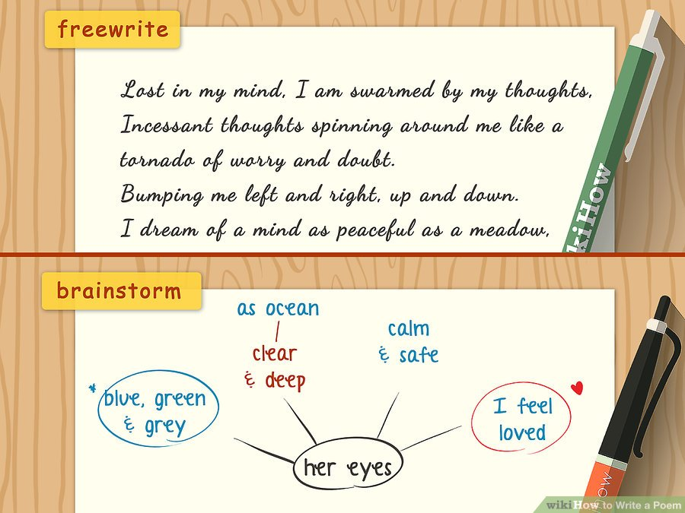

Slide 6
Tips #2
Get inspired by your environment and those close to you.
Think of every memory, situation, and moment as a possible topic and you’ll start seeing poetry all around you!
Finding a Topic Go for a walk. Head to your favorite park or spot in the city, or just take a walk through your neighborhood. Use the people you see and the nature and buildings you pass as inspiration for a poem.
Write about someone you care about. Think about someone who’s really important to you, like a parent or your best friend. Recall a special moment you shared with them and use it to form a poem that shows that you care about them.
Pick a memory you have strong feelings about. Close your eyes, clear your head, and see what memories come to the forefront of your mind. Pay attention to what emotions they bring up for you—positive or negative—and probe into those. Strong emotional moments make for beautiful, interesting poems.

Slide 7
2

Slide 8
Tips #3
Pick A Specific Theme or Idea.
You can start your poem by focusing on a specific theme or idea that you find fascinating or interesting. Picking a specific theme or idea to focus on in the poem can give your poem a clear goal or objective. This can make it easier for you to narrow down what images and descriptions you are going to use in your poem.
For example, you may decide to write a poem around the theme of “love and friendship.” You may then think about specific moments in your life where you experienced love and friendship as well as how you would characterize love and friendship based on your relationships with others.
Try to be specific when you choose a theme or idea, as this can help your poem feel less vague or unclear. For example, rather than choose the general theme of “loss,” you may choose the more specific theme, such as “loss of a child” or “loss of a best friend.”
words.

Slide 9
Tips #4
Choose A Poetic Form.
Get your creative juices flowing by picking a form for your poem. There are many different poetic forms that you can use, from free verse to sonnet to rhyming couplet.
You may go for a poetic form that you find easy to use, such as free verse, or a form that you find more challenging, such as a sonnet. Choose one poetic form and stick to that structure so your poem feels cohesive to your reader. You may decide to try a poetic form that is short, such as the haiku, the cinquain, or the shape poem. You could then play around with the poetic form and have fun with the challenges of a particular form.
You may opt for a form that is more funny and playful, such as the limerick form, if you are trying to write a funny poem. Or you may go for a more lyrical form like the sonnet, the ballad, or the rhyming couplet for a poem that is more dramatic and romantic.

Slide 11
Tips #5
Read examples of poetry.
To get a better sense of what other poets are writing, you may look through examples of poetry. You may read poems written in the same poetic form you are interested in or poems about themes or ideas that you find inspiring. You may also choose poems that are well known and considered “classics” to get a better sense of the genre. For example, you may read:
“Kubla Khan” by Samuel Taylor Coleridge
“Song of Myself” by Walt Whitman
“I measure every Grief I meet” by Emily Dickinson
“Sonnet 18” by William Shakespeare
“One Art” by Elizabeth Bishop
“Night Funeral in Harlem” by Langston Hughes
“The Red Wheelbarrow” by William Carlos Williams

Slide 12
Tips #6
Use concrete imagery.
Avoid abstract imagery and go for concrete descriptions of people, places, and things in your poem. You should always try to describe something using the five senses: smell, taste, touch, sight, and sound.
Using concrete imagery will immerse your reader in the world of your poem and make images come alive for them.
For example, rather than try to describe a feeling or image with abstract words, use concrete words instead. Rather than write, “I felt happy,” you may use concrete words to create a concrete image, such as, “My smile lit up the room like wildfire.”
-

Slide 13
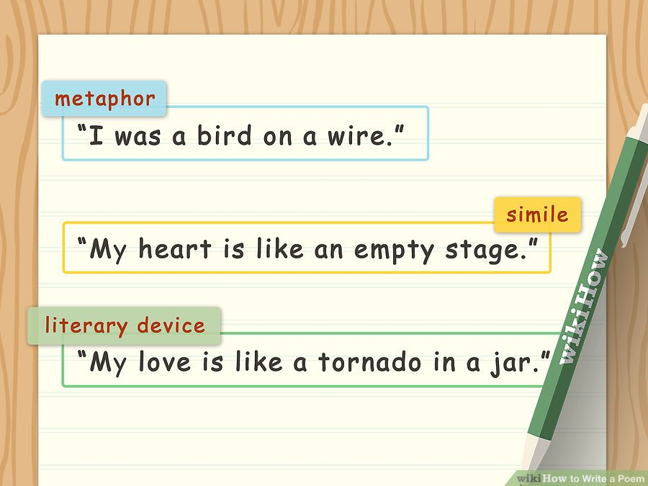

Slide 14
Tips #7
Include Literary Devices.
Try to use literary devices throughout your poem, varying them so you do not use only metaphors or only similes in your writing.
Try a New Literary Device Metaphor: This device compares one thing to another in a surprising way. A metaphor is a great way to add unique imagery and create an interesting tone. Example: “I was a bird on a wire, trying not to look down.” Simile: Similes compare two things using “like” or “as.” They might seem interchangeable with metaphors, but both create a different flow and rhythm you can play with. Example: “She was as alone as a crow in a field,” or “My heart is like an empty stage.” Personification: If you personify an object or idea, you’re describing it by using human qualities or attributes. This can clear up abstract ideas or images that are hard to visualize. Example: “The wind breathed in the night.” Alliteration: Alliteration occurs when you use words in quick succession that begin with the same letter. This is a great tool if you want to play with the way your poem sounds. Example: “Lucy let her luck linger.”
“There were nights when the wind was so cold..
There were days when the sun was so cruel”
-
It's
All Coming Back to Me Now
by Celine Dion

Slide 16
Tips #8
“
Write for the Ear.
Poetry is made to be read out loud and you should write your poem with a focus on how it sounds on the page. Writing for the ear will allow you to play with the structure of your poem and your word choice. Notice how each line of your poem flows into one another and how placing one word next to another creates a certain sound
For example, you may notice how the word “glow” sounds compared to the word “glitter.” “Glow” has an “ow” sound, which conjures an image of warmth and softness to the listener. The word “glitter” is two syllables and has a more pronounced “tt” sound. This word creates a sharper, more rhythmic sound for the listener.
-
Perfect Two by Auburn

Slide 17
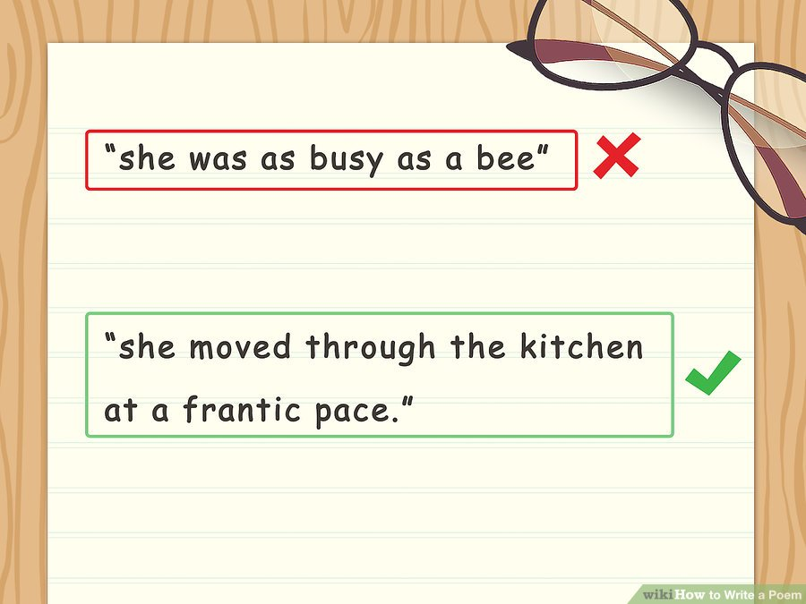

Slide 18
Tips #9
Avoid Cliche.
Your poetry will be much stronger if you avoid cliches, which are phrases that have become so familiar they have lost their meaning.
Go for creative descriptions and images in your poem so your reader is surprised and intrigued by your writing. If you feel a certain phrase or image will be too familiar to your reader, replace it with a more unique phrase.
For example, you may notice you have used the cliche, “she was as busy as a bee” to describe a person in your poem. You may replace this cliche with a more unique phrase, such as “her hands were always occupied” or “she moved through the kitchen at a frantic pace.”

Slide 19
Tips #10
Read the Poem Out Loud.
Once you have completed a draft of the poem, you should read it aloud to yourself.
Notice how the words sound on the page.
Pay attention to how each line of your poem flows into the next.
Keep a pen close by so you can mark any lines or words that sound awkward or jumbled.
You may also read the poem out loud to others, such as friends, family, or a partner. Have them respond to the poem on the initial listen and notice if they seem confused or unclear about certain phrases or lines.

Slide 20
Tips #11
Get Feedback from Others.
You can also share your poem with other poets to get feedback from them and improve your poem.
You may join a poetry writing group, where you workshop your poems with other poets and work on your poetry together.
Or you may take a poetry writing class where you work with an instructor and other aspiring poets to improve your writing.
You can then take the feedback you receive from your peers and use it in your revision of the poem.

Slide 21
Tips #12
Revise Your Poem.
Once you have received feedback on your poem, you should revise it until it is at its best. Use feedback from others to cut out any lines to feel confusing or unclear.
Be willing to “kill your darlings” and not hold onto pretty lines just for the sake of including them in the poem.
Make sure every line of the poem contributes to the overall goal, theme, or idea of the poem.
You may go over the poem with a fine tooth comb and remove any cliches or familiar phrases. You should also make sure spelling and grammar in the poem is correct.

