Slide 1
POETIC STUDY
SESSION 14
ROSALINA NUGRAHENI WULAN PURNAMI., M.Pd.
PENDIDIKAN BAHASA INGGRIS, FKIP

Slide 2
Genre/Form of Poetry:
Analyse Poems: Sound, Meaning, and Sense Devices

Slide 3
LEARNING OUTCOME
Students are able to analyze a poem based on its sound, meaning, and sense devices.

Slide 4
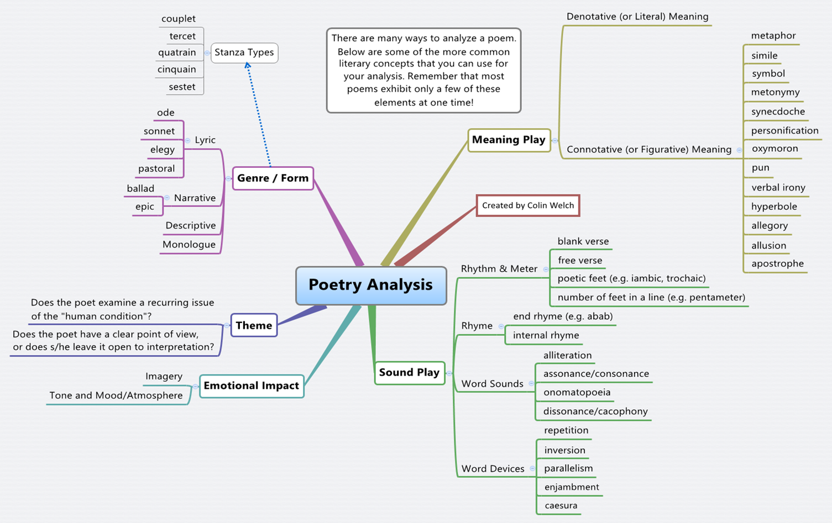

Slide 5
Choose one poem: Classic or Contemporary
Summarize the poem.
Analyze the poem you have chosen based on its:
Sound Devices
Meaning Devices
Sense Devices
Write down your personal reflection on the poem you have chosen.
Type your analysis:
Font : Times News Roman
Font Size : 12
Spacing : double
Margins : 3 on all sides

Slide 6
Classic Poems
“Ulysses” by Alfred, Lord Tennyson
“If–” by Rudyard Kipling
“Sailing to Byzantium” by W. B. Yeats
“Sonnet 29” by William Shakespeare
“Invictus” by William Ernest Henley
“Mending Wall” by Robert Frost
“Horatius” by Thomas Babington
“The Builders” by Henry Wadsworth Longfellow
“The Negro Speaks of Rivers” by Langston Hughes

Slide 7
Contemporary Poems
“I know why the caged bird sings” by Maya Angelou
“Silent Mark” by Cecilia Borromeo
“Nothing grows except the grass…” by Carlos Barbarito
“HOPE” by Siddharth Anand
“A Mermaid Questions God” by Kelli Russell Agodon
“Cold Morning” by Eamon Grennan
“A SIMPLE SONG” by Vlanes (Vladislav Nekliaev)
“A New Broom” by Witt Wittmann
“Unobtainable” by Hugo Williams

Slide 8
“The Little Black Boy” by William Blake
The poem under analysis is taken from a compilation of works by William Blake—Songs of Innocence and Experience, and is called The Little Black Boy. William Blake was a British poet, painter, and engraver. Most of his works belong to the literary era of Romanticism. His poetry does not only embrace the characteristic features of this age, but also has certain deviations from its norms. The poet employs a wide usage of metaphors, similes, personification, and other poetic devices, which make his works colorful and engaging.
With regard to The Little Black Boy, this poem belongs to the genre of lyrical poetry and depicts the social issues that existed at the time of its creation. First of all, the author hints that racial discrimination that was present in the United Kingdom and this problem is still relevant. Therefore, it affects a modern-day person when he or she reads this poem. Moreover, the poem highlights the concept of equality among all people. Blake strives to deliver the message that there should be no discrimination of any kind against those living in the same country, or generally, on the same planet.

Slide 9
With reference to the poem’s imagery, the devices present mostly appeal to the reader’s visual and tactile senses. The black and white colors used in the descriptions serve not only to differentiate the races, but also to impart the child’s understanding of good and bad. For example, the line, “And I am black, but Oh! my soul is white,” shows us the degree of the boy’s awareness. The little child stands for the whole nation, being vulnerable under the rule of those who are not tolerant of people who have a different appearance. The mood of the poem is nostalgic and absorbing. It gives the reader a chance to mull over the fact of the boy’s self-perception and the effect his society has on racial minorities.

Slide 10
Blake employs a great variety of metaphors. For instance, in the line “Look on the rising sun: there God does live and gives his light, and gives his heat away.” God said to be the sun—a being that provides people with light, warmth, and hope. Moreover, light is a conceptual metaphor for knowledge that lies in the human mind. Therefore, the image of the boy’s sun-burnt face is in fact a sign of his desire to be educated and become a thinking being. The reason for that also is in the known fact that at the time when the poem was created, Africans living in Britain and in the US were deprived of the opportunity to receive appropriate education as a result of racial segregation. There were certain colleges only Caucasian people were allowed to enter. This dreadful reality definitely affected future life opportunities of Africans living in the US and Britain. Another metaphor and simile is in the line: “And these black bodies and this sun-burnt face are but a cloud, and like a shady grove.” Africans are compared to the cloud; the white men presumed that their abilities were not equal; that the blacks cannot gain as much knowledge and experience as the whites.

Slide 11
I am inclined to believe that the issue depicted in the poem still exists in present-day British society and should be resolved by the teaching of common acceptance of those who are different. The message of the poem is to treat everyone as you would yourself, whether this person appears to be of a different race, status, gender, or otherwise. In my view, William Blake was successful in bringing up such ideas, and due to his ability to affect the human senses and raise disputable topics, even modern society may benefit from it and come up with certain solutions to the problems he presented. Therefore, the poetry of such talented individuals should be cherished and studied in an obligatory literature course.

