Slide 1

POETIC STUDY
SESSION 7
ROSALINA NUGRAHENI WULAN PURNAMI., M.Pd.
PENDIDIKAN BAHASA INGGRIS, FKIP

Slide 2

Genre/Form of Poetry:
Analyzing Poem

Slide 3

LEARNING OUTCOME
Students are able to analyze a sample of poem based on its elements, genre, and stanza types of poetry they have learnt previously.

Slide 4
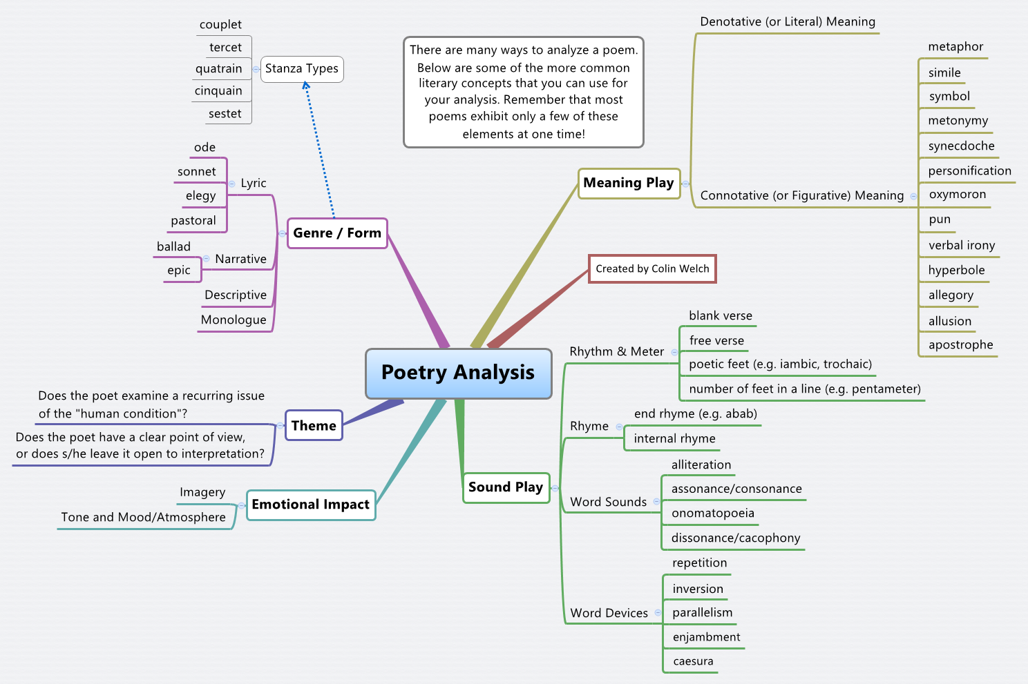

Slide 5
What is a Poetry Analysis?
Poetry analysis is the process of reviewing the multiple artistic, functional, and structural pieces that make up a poem.
Typically, this review is conducted and recorded within the structure of a literary analysis essay.
This type of essay writing requires one to take a more in-depth look at both the choices that a poet made and the overall effects of those choices. These papers need an detailed analysis of all of the parts that were used to form a work of poetry.

Slide 6
Pre-Writing Steps to Take
To compose a poetry analysis essay, one must first read the poem carefully. It is essential to reread the literary piece several times to get a full grasp of the numerous ideas and concepts. This also gives you an opportunity to make note of the rhyme scheme (if there is one), the type of poem (Limerick, ode, sonnet, lyric, haiku, free verse, etc.) and other poetic elements (Extrinsic and Intrinsic)
All of those elements of the poem are essential to know when one is writing a poetry analysis essay because they are a part of the poem’s structure and can affect the content.

Slide 7
After covering the technical aspects of a poem, it is best to learn about the background of the poem. This means that one may find it beneficial to look up the poet, the date that the poem was written, and the cultural context of the work.
All of that information typically gives the reader a more in-depth understanding of the poem, and it seems self-explanatory that one who has an enhanced comprehension of the poem would have an easier time analyzing that poem.

Slide 8
The final element of writing a poetry analysis essay is a part of the composition dedicated to the subject matter of the poem. This can be analyzed during the reader’s quest to determine the theme, tone, mood, and meaning of the poem.
The subject matter – and the thematic elements that support the intended message behind the subject – is often an interpretive minefield.
an excellent essay writer always contributes their ideas and observations, making the work unique... The writer should be careful to not mistake this with choosing a popular opinion or biased one. They should be defending the one that carries the most weight or offers the most validation! As the essay is to be an analysis, opinions are to be avoided in favor of facts and conjectures that are backed by evidence from work.

Slide 9
“Auto Wreck” by Karl Shapiro - From Oregon Arts Commission
Summary: The poem starts with a description of an ambulance rushing to the scene of a crash, and hurriedly gathering up the victims and rushing them away. The 2nd and 3rd stanzas explore the emotions felt after the car crash from the perspective of a witness. 8.
Theme: A significant issue from “Auto Wreck” is death. The author is exploring the random and illogical nature of mortality by contrasting the car crash with other forms of death (war, suicide, stillbirth, cancer) that are more understandable. 9.
Mood: gloomy, reflective 10. “Auto Wreck” is a lyric poem because it gives a description of an event and reflections on it, but does not tell a story. 11.

Slide 10
Personal reflections:
I selected this poem because of the realistic images and how a reader can vividly picture the accident as if he/she was there to see it. It’s a morbid poem, but the theme is relevant since everyone will die someday and no one knows if it will be sudden, like a car crash, or come on slowly like cancer. My favorite line is, “One with a bucket douches ponds of blood.” It refers to the policeman washing away the artificial ponds of blood from the accident. I know this line is unpleasant, but I like it because it so powerfully displays the shock of the onlooker. 12. “Auto Wreck” reminds me of John Donne’s poem, “Death Be Not Proud” because of they both deal with the themes of mortality. They are different poems since Donne’s poetry denies death’s power and mock’s death, while Shapiro seems perplexed by the unpredictableness of death by car crashes.

Slide 11
Kabir, a 15th century saint and poet from India, wrote poems that rallied against organized religion and called for divine experience rather than dogma. His poems are usually simple but profound, having metaphors that are easy even for lay people to understand, with some exceptions. In a land full of religions and spiritual practices, Kabir exposed the hypocrisy of rituals practiced by those where he lived. His poems are still potent today, and we can still learn from his poetry in our time of jihad, Christian-democratic wars, and battles between religious sects.
I will present the poem first in its entirety and then I will analyze it. The English versionwas translated from original Hindi by renowned poet Rabindranath Tagore.
  There is nothing but water in the holy bathing places
  and I know that they are useless, for I have bathed in them.
  The images are all lifeless, they cannot speak–
  I know, for I have cried aloud to them.
  The Purana and the Koran are mere words–
  lifting up the curtain, I have seen.
  Kabir gives utterance to the words of experience
  and he knows very well that all other things are untrue.
——————————————————–

Slide 12
We can look at each stanza, deciphering its meaning.
Stanza one:
There is a tradition in India to bathe in waters deemed holy. It is believed these waters will cleanse people’s spiritual state and even rectify individuals for their past mistakes. Kabir is saying this belief is mere superstition rather than fact. This is an important message, as people in India generally believe this to be so true, that they bathe in a holy river one time and think they have been released from of all of their karma.
Stanza two:
The images he is talking about are the idols people worship, usually in the form of the gods Vishnu, Shiva, Brahma, or Ganesha. Kabir is essentially saying God is formless, and cannot be placed in idols, which are human made. In Hinduism, it is a common practice to place idols in temples, in the home, or in the workplace and worship them as God itself.
Stanza three:
This is a controversial stanza, as Muslims regard the Koran as the absolute word of God, untarnished. This is also true for most religious people and the holy books they use. But Kabir believes these holy books are not experiential, and therefore merely words. When he says “lifting up the curtain” he means to say he saw the holy books in person, which were usually only read by high people in society at the time, and not a weaver like Kabir.
Stanza four:
This stanza explains why Kabir displayed his animosity towards the holy bathing places, idols, and holy books. He says only experience is the true spirituality and not completing rituals. The mundane activities we do in life cannot connect us to God, but only the experience of God itself can give us salvation.

Slide 14
Your analysis should be typed:
Font: Times New Roman 12
Spaces: 2
Margin:

