Slide 1
REFLECTION PERKULIAHAN
Pertemuan Ke-14
Nurul Febrianti, M.Pd
Prodi PGSD FKIP

Slide 2
Education for Citizenship: Ideas into Action A Practical Guide for Teachers of Pupils Aged 7-14
Nurul Febrianti, M.Pd.

Slide 3
Today’s children also face dilemmas of split of loyalties. They are learning to be citizens across the continuum of sometimes contrasting environments – the home, the street, and the school. In many communities this can be a complex experience as described by a parent in a recent interview for a study into citizenship education.
Notes:
Anak-anak hari ini juga menghadapi dilema perpecahan loyalitas. Mereka belajar menjadi warga melintasi rangkaian lingkungan yang terkadang kontras - rumah, jalanan, dan sekolah. Di banyak komunitas, ini bisa menjadi pengalaman yang kompleks seperti yang dijelaskan oleh orang tua dalam sebuah wawancara baru-baru ini untuk sebuah studi tentang pendidikan kewarganegaraan.

Slide 4
Where there are dilemmas there is a need for guidance, support and a set of values which can be upheld. This process is summarized by the philosopher Blackburn in his recent book ‘Being Good’.
“We need standards of behavior in our eyes and we need recognition in the eyes of other”. –Blackburn 2001: 133)
Notes:
Dimana ada dilema ada kebutuhan akan bimbingan, dukungan dan seperangkat nilai yang bisa ditegakkan. Proses ini diringkas oleh filsuf Blackburn dalam buku terbarunya 'Being Good'."Kita membutuhkan standar perilaku di mata kita dan kita butuh pengakuan di mata orang lain"

Slide 5
“All human beings are born free and equal in dignity and rights. They are endowed with reason and conscience and should act towards one another in spirit of brotherhood”. (Article One)
Notes:
Mereka dianugerahi akal dan hati nurani dan harus bertindak satu sama lain dalam semangat persaudaraan

Slide 6
Learning Outcomes for Citizenship Education Relate to:
Truth
Honesty
Justice
Trust
Sense of Duty

Slide 7
Truth
Teachers and learners will be concerned to:
Research topical and political issues, through collecting evidence from a full of sources of information including those reflecting different perspectives.
Understand self in relation to other.
Notes:
Meneliti isu topikal dan politis, melalui pengumpulan bukti dari sumber informasi yang lengkap termasuk yang mencerminkan perspektif yang berbeda.Pahami diri sendiri sehubungan dengan hal lainnya.

Slide 8
Honesty
Teachers and learners will be concerned to:
Explore how the media present information.
Recognize stereotypes and other forms of unfair representation.
Notes:
Jelajahi bagaimana media menyajikan informasi.Kenali stereotip dan bentuk representasi tidak adil lainnya.

Slide 9
Justice
Teachers and learners will be concerned to:
Understand that resources can be allocated in different ways and that these economic choices affect individuals and communities.
Reflect critically on their own views of the lives of people living in other place and times and people with different values and customs.
Notes:
Pahami bahwa sumber daya dapat dialokasikan dengan cara yang berbeda dan pilihan ekonomi ini mempengaruhi individu dan masyarakat.Renungkan secara kritis pandangan mereka sendiri tentang kehidupan orang-orang yang tinggal di tempat dan waktu lain dan orang-orang dengan nilai dan kebiasaan yang berbeda.

Slide 10
Trust
Teachers and learners will be concerned to:
Recognize that the voices of children should be heard.
Recognize that the law of the land and Human Rights Conventions protect citizens.

Slide 11
Sense of Duty
Teachers and learners will be concerned to:
Ensure that children can and do participate in the decision-making process of the school.
Challenge stereotypes and other forms of injustice.
Notes:
Tantang stereotip dan bentuk ketidakadilan lainnya.

Slide 12
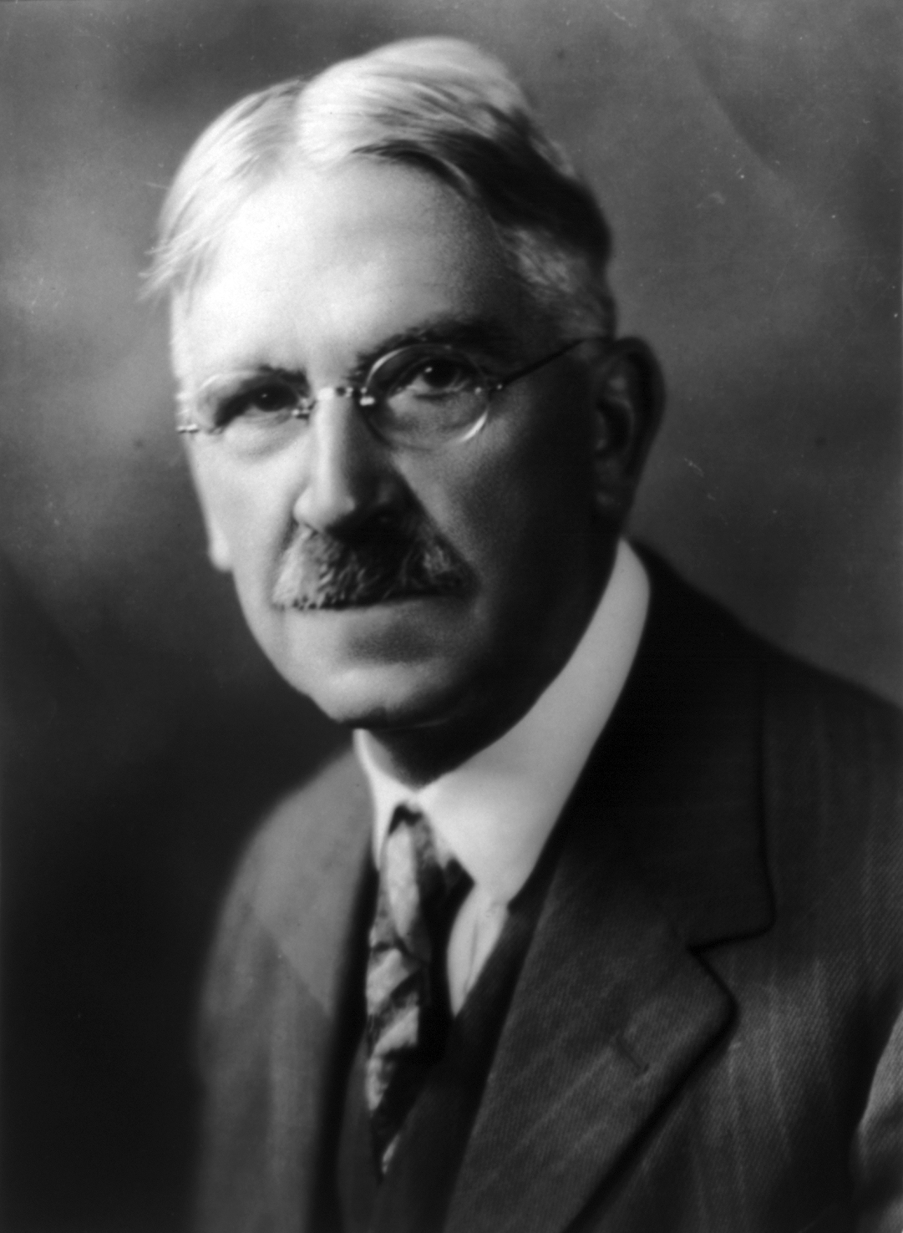
“School have the responsibility to bring democracy into school and classrooms”.

Slide 13
Citizenship Education Requires Student to:
Develop confidence to voice own opinions
Develop skills in recognizing the views/experience of other individuals and groups
Develop skills in critical thinking and in developing arguments
Develop skills of co-operation and conflict resolution
Trust in their creative powers
Develop skills of democratic participation
Gain experience of taking action for change
Notes:
Dapatkan pengalaman mengambil tindakan untuk perubahan

Slide 14
Example of Active Learning Approaches
Small group discussions followed by plenary sessions to develop and synthesize arguments
Open-ended collaboration enquiries on topical and controversial issues
Role play, simulations and debates that reflect events in society
Critically evaluating diverse sources of information
Direct interaction with community members
Live correspondence with others living/working inside and outside of the immediate locality
Entering the live of others through stories, biographies and other media
Participating in democratic processes of change
Notes:
Pertanyaan kolaborasi terbuka
Tinggal korespondensi dengan orang lain yang tinggal / bekerja di dalam dan di luar wilayah terdekat
Memasuki kehidupan orang lain melalui cerita, biografi dan media lainnya

Slide 15
The content cover the full range of themes identified within the framework for education for citizenship in the National Curriculum for England including:
Social and Moral Education
Community Involvement
Political Literacy
Notes:
Isi mencakup berbagai tema yang diidentifikasi dalam kerangka pendidikan kewarganegaraan dalam Kurikulum Nasional untuk Inggris termasuk

Slide 16
The activities are all based on a common framework which identifies:
Purpose: identifying learning outcomes related to education for citizenship and other subject areas.
Preparation: providing information about resources needed.
Procedure: providing guidance on the content and sequence of the activities, from whole class introductions to group work; providing examples of key questions to encourage discussion and involvement.
Plenary: providing points of focus which will encourage students to analyze their findings and draw conclusions.
Possibilities: providing ideas for follow-up activities.

Slide 17
Handling Controversial Issues
“Controversial issues are important in themselves and to omit informing about and discussing them to leave a wide and significant gap in the educational experience of young people”. (QCA 1998: 56)
Notes:
Isu kontroversial penting dalam diri mereka dan untuk tidak menginformasikan dan mendiskusikannya untuk meninggalkan kesenjangan yang luas dan signifikan dalam pengalaman pendidikan orang muda.

Slide 18
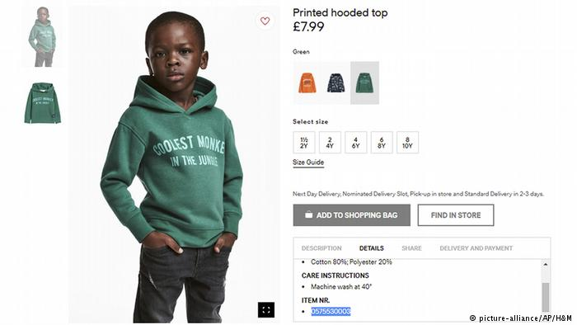
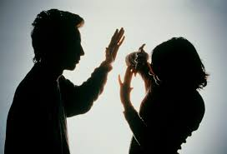
Issues which frequently arise with children relate to the use of drugs, racist incidents, bullying and acts of violence or vandalism in the community.

Slide 19
Neutrality
Neutrality is recommended as a strategy because the teacher acting as an impartial chair can enable children to extend their thinking skills
(Netralitas direkomendasikan sebagai strategi karena guru yang bertindak sebagai kursi yang tidak memihak dapat memungkinkan anak-anak untuk memperluas kemampuan berpikir mereka)

Slide 20
Education for citizenship [should] include human rights principles; skills of deliberation, advocacy and campaigning; open mindedness and tolerance of difference; knowledge of global interdependence; understanding of equality legislation; and opposition to racist beliefs and behavior. (Runnymede 2000: 149)
Notes:
Pendidikan kewarganegaraan harus mencakup prinsip-prinsip hak asasi manusia; keterampilan musyawarah, advokasi dan kampanye; keterbukaan dan toleransi perbedaan; pengetahuan tentang saling ketergantungan global; pemahaman tentang undang-undang kesetaraan; dan oposisi terhadap keyakinan dan perilaku rasis

Slide 21
Rationale for Citizenship Education Effective citizens of the twenty-first century will:
Work co-operatively with others
Develop social justice principle to guide own actions
Think in a critical and systemic way
Appreciate and learn from cultural differences
Evaluate problems in the wider community and global context
Resolve conflicts non-violently
Change lifestyles to protect the environment
Recognize and defend human rights
Dare to strive for a fairer future
Participate in democratic politics
Notes:
Berani berjuang untuk masa depan yang lebih adil

Slide 22
Purpose of Citizenship Education Schools need a curriculum for citizenship education which:
Provides opportunities for the development of values based on social justice and human rights principles
Encourages respect for different national, religious and ethnic identities and opposition to racist beliefs and behavior
Links the school with local communities and encourages intercultural learning
Teaches about democracy and the law (past, present, and future)
Addresses economic and environmental issues
Provides opportunities for students to set the agenda, to voice their own concerns and to negotiate some areas of learning
Teaches skills of collaborative working, advocacy and campaigning
Models participation in democratic and political processes
Promotes critical thinking and interactive learning
Is realized through the ethos and actions of the school, so that students feel that teachers are fair and that their voices are heard, recognized and acted upon.
Notes:
Terwujud melalui etos dan tindakan sekolah, sehingga siswa merasa bahwa guru adil dan suara mereka didengar, dikenali dan ditindaklanjuti.

