Slide 1
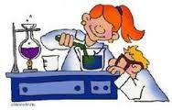
Teaching Demo 1
Noni Agustina

Slide 2
Direction
You will have teaching demonstration (micro teaching) by following some direction as follows:
Choose one topic related to English material in elementary curriculum.
Make a lesson plan by following some components provided before.
Prepare the various learning media.
Create the creative, innovative, fun learning and teaching process in the class.
Learn the rubric below to measure your performance carefully:

Slide 3
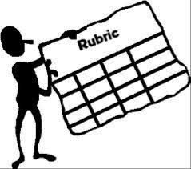
Look at the rubric below!

Slide 4
REFERENCE
Kay, Penny Mc and Jenni Guse. 2007. Five-minute activities for young learner. UK: Cambridge handbook for language.
Scott, Wendy and Lisbeth Ytreberg. 2010. Teaching English to children. USA: Longman
Woodward, Tessa. 2009. Planning Lessons and Courses. Cambridge: Cambridge University Press.

