Slide 1
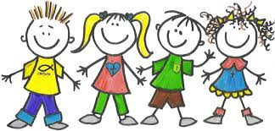
Teaching Young Language Learner
Noni Agustina

Slide 2
Young language learner
Five to seven years old children
Five to seven years old children
Do they do the same things?

Slide 3
Characteristics of five to seven years old children
Love to play
Learn best if they like the activities
Understand the language skills but they are not aware
Have short attention and concentration span
Have difficulty to understand between fact and fiction
Have strong imagination
Work alone

Slide 4
Characteristics of eight to ten years old children
Have basic concepts
Can understand between fact and fiction
Can make decision to learn
Able to work with others

Slide 5
What should we do to teach English?
Use many objects or pictures
Demonstrate what you do
Exposure the language by singing or telling stories
Use variety of activity, pace, organization, and voice.
Apply the routine (repeat the situations or activities)
Make regular note to assess student’s progress

Slide 6
REFERENCE
Kay, Penny Mc and Jenni Guse. 2007. Five-minute activities for young learner. UK: Cambridge handbook for language.
Scott, Wendy and Lisbeth Ytreberg. 2010. Teaching English to children. USA: Longman

