Slide 1
Five-minute Activities: About Me
Noni Agustina

Slide 2
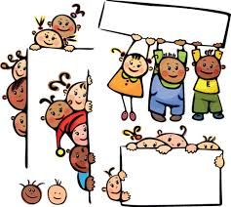
Sub-Themes
My family
My classroom
My home
My freetime
My friends
My birthday party
My favourite TV show

Slide 3
Direction
Choose some of sub-themes listed
Show the interesting and fun activities related to those sub-themes
Provide the learning media/aids to support your activities
Manage your time in performing in front of the class

Slide 4
REFERENCE
Scott, Wendy A., and Lisbeth. 2010. Teaching English to children. USA: Longman

