Slide 1
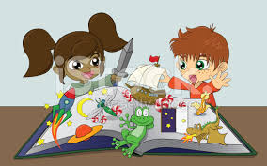
Five-minute Activities: Fantasy and Adventure
Noni Agustina

Slide 2
Simple Past
Activity began and ended in the past
Adverb of time:
Yesterday, last week/month/year, one minute ago/etc.
1. Be (was/were)
John was a student.
They were happy.
She/he/it/I
was
You/they/we
were
2. Verb
loved
Regular form (-d/-ed/-ied)
watched
She/he/it/I/you/they/we
Simple past form (verb 2)
tried (try)
Irregular form
go - went
did
Positive Sentence | Negative Sentence | Interrogative Sentence
I woke up yesterday morning. | We did not drink juice yesterday. | Did they speak Japanese yesterday?

Slide 3
Regular Verb
Simple form | Simple past | Present participle
hope | hoped | hoped
study | studied | studied
Irregular Verb
Simple form | Simple past | Present participle
become | became | become
bite | bit | bitten
go | went | gone
buy | bought | bought
eat | ate | eaten
Find the other irregular verbs!

Slide 4
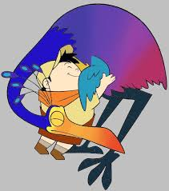
Sub-Themes
The king and the dragon
Draw dinosaur
Queen family
Goldilock
Create fantasy tale

Slide 5
Direction
Choose some of sub-themes listed
Show the interesting and fun activities related to those sub-themes
Provide the learning media/aids to support your activities
Manage your time in performing in front of the class

Slide 6
REFERENCE
Scott, Wendy A., and Lisbeth. 2010. Teaching English to children. USA: Longman

