Slide 1
Teaching Reading for Young Learners
Noni Agustina

Slide 4
Matching picture with paragraph

Slide 16
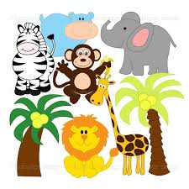
zoo

Slide 17
elephant

Slide 18
monkey

Slide 19
zebra

Slide 20
giraffe

Slide 21
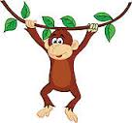
climb

Slide 22
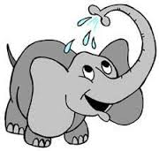
take water

Slide 23
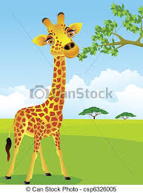
take leaves

Slide 24
Read the text and answer the questions!
It is a zoo. There are so many animals there. They are elephant, monkey, zebra and giraffe. The monkey can limb. The giraffe can take leaves high. The elephant can take water with its long nose.
Where are the animals?
What animals are there?
What can the monkey do?
What does the giraffe take?
How does the elephant take water?

