Slide 1
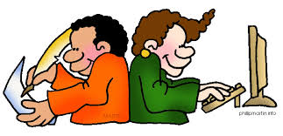
Teaching Writing for Young Learners
Noni Agustina

Slide 2
Writing Activities
Controlled writing activities
Straight copying
Matching
Organizing and copying
Delayed copying

Slide 3
Writing Activities
Guided writing activities
Fill-in exercises
Dictation
Letters/cards/invitation

Slide 4
Writing Activities
Free writing activities
Pre-writing activities
Word stars
Vocabulary chart
Description
Letters
Dialogue

Slide 5
REFERENCE
Kay, Penny Mc and Jenni Guse. 2007. Five-minute activities for young learner. UK: Cambridge handbook for language.
Scott, Wendy and Lisbeth Ytreberg. 2010. Teaching English to children. USA: Longman

