Slide 1
Overview
The Caregiver-Child Attachment Relationship
Attachment Theory
Measurement of Attachment Security
Factors Associated with the Security of Children’s Attachment
Does Security of Attachment Have Long-Term Effects?
Conceptions of the Self
The Development of Conceptions of Self
Erikson’s Views

Slide 2
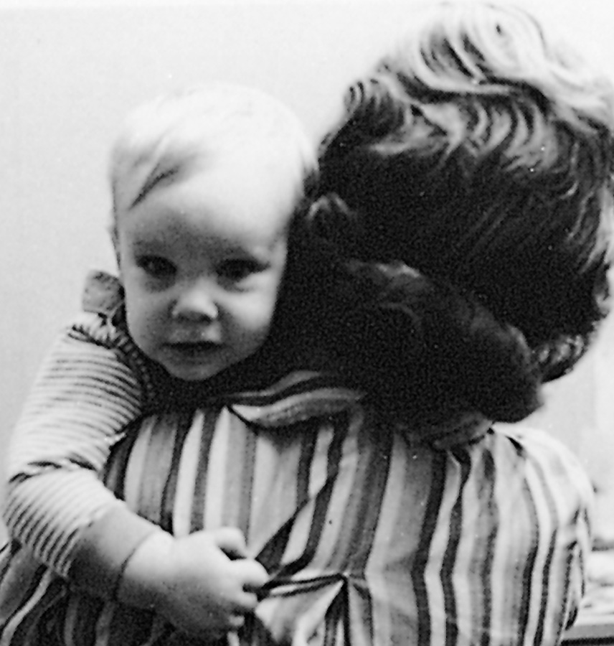
Attachment
An emotional bond with a specific person that is enduring across space and time
The observations of John Bowlby and others involved with institutionalised children led to an understanding of the importance of parent-child interactions in development

Slide 3
Attachment
Many investigators now believe that children’s early relationships with parents influence the nature of their interactions with others from infancy into adulthood, as well as their feelings about their own worth

Slide 4
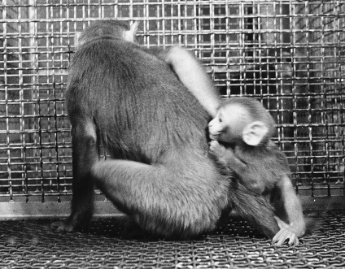
Harry Harlow
Experimental work with monkeys who were deprived of all early social interactions strongly supported the view that healthy social and emotional development is rooted in children’s early social interactions with adults

Slide 5
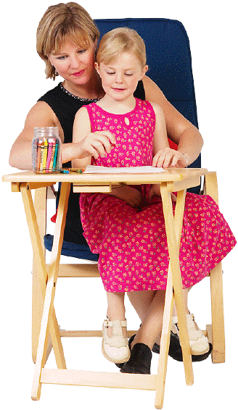
Bowlby and Ainsworth
John Bowlby proposed attachment theory, which is influenced by ethological theory and posits that children are biologically predisposed to develop attachments with caregivers as a means of increasing the chances of their own survival

Slide 6
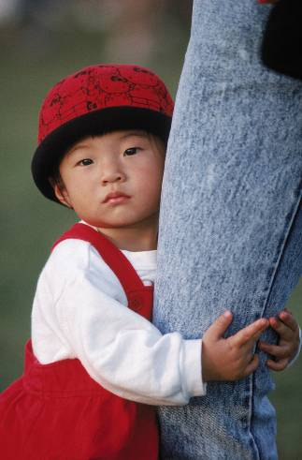
Bowlby and Ainsworth
Secure base is Bowlby’s term for an attachment figure’s presence that provides an infant or toddler with a sense of security that makes it possible for the infant to explore the environment
Mary Ainsworth, Bowlby’s student, extended and tested his ideas

Slide 7
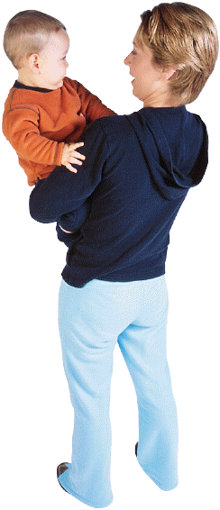
Bowlby’s Four Phases of Attachment
Preattachment phase (birth to 6 weeks) The infant produces innate signals that bring others to his or her side and is comforted by the interaction that follows
Attachment-in-the-making (6 weeks to 6-8 months) The phase in which infants begin to respond preferentially to familiar people

Slide 8
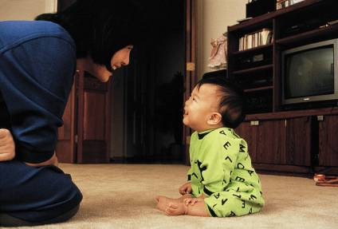
Bowlby’s Four Phases of Attachment
Clear-cut attachment (between 6-8 months and 1½-2 years) Characterised by the infant’s actively seeking contact with their regular caregivers and typically showing separation protest or distress when the caregiver departs
Reciprocal relationships (from 1½ or 2 years on) Involves children taking an active role in developing working partnerships with their caregivers

Slide 9
The Strange Situation
Ainsworth developed a laboratory procedure called “The Strange Situation” to assess infants’ attachment to their primary caregivers
In this procedure, the child is exposed to seven episodes, including two separations and reunions with the caregiver and interactions with a stranger when alone and when the caregiver is in the room
Using this procedure, Ainsworth identified three attachment categories

Slide 10
Attachment Categories
Secure Attachment is a pattern of attachment in which an infant or child has a high-quality, relatively unambivalent relationship with his or her attachment figure
In the Strange Situation, a securely attached infant, for example, may be upset when the caregiver leaves but may be happy to see the caregiver return, recovering quickly from any distress
When children are securely attached, they can use caregivers as a secure base for exploration
About two-thirds of American middle class children are securely attached

Slide 11
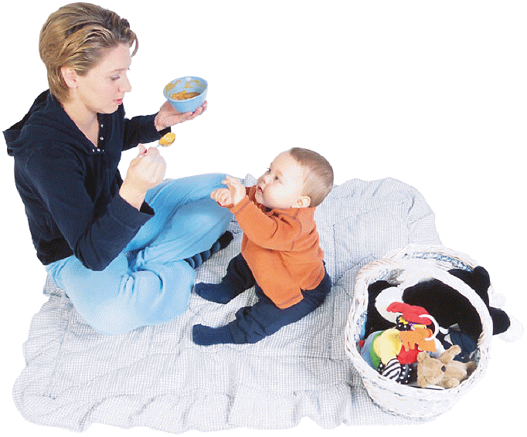
Attachment Categories
Insecure/resistant (or ambivalent) attachment is a pattern in which infants or young children (about 15% of American middle class children) are clingy and stay close to their caregiver rather than explore the environment
In the Strange Situation, insecure/resistant infants tend to become very upset when the caregiver leaves them alone in the room, and are not readily comforted by strangers
When the caregiver returns, they are not easily comforted and both seek comfort and resist efforts by the caregiver to comfort them

Slide 12
Attachment Categories
Insecure/avoidant attachment is a type of insecure attachment in which infants or young children (about 20% of infants from middle-class U.S. families) seem somewhat indifferent toward their caregiver and may even avoid the caregiver
In the Strange Situation, these children seem indifferent toward their caregiver before the caregiver leaves the room and indifferent or avoidant when the caregiver returns
If these children become upset when left alone, they are as easily comforted by a stranger as by the caregiver

Slide 13
Attachment Categories
Because a small percentage of children did not fit into these categories, a fourth category, disorganised/disoriented attachment, was subsequently identified
Infants in this category seem to have no consistent way of coping with the stress of the Strange Situation
Their behaviour is often confused or even contradictory, and they often appear dazed or disoriented

Slide 14
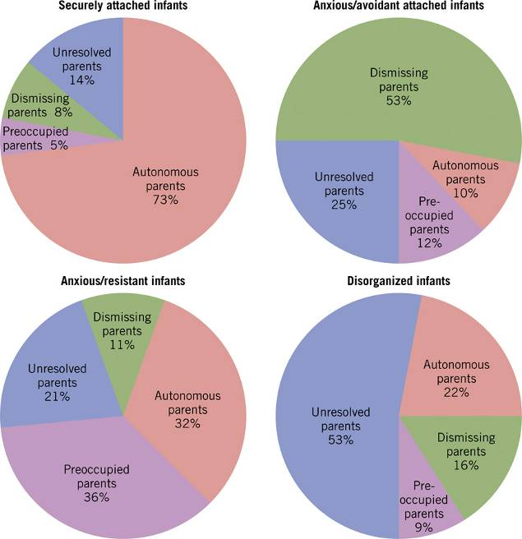
Parents with secure adult attachments tend to have securely attached children.

Slide 15
Long-Term Effects
Children who were securely attached as infants seem to have closer, more harmonious relationships with peers than do insecurely attached children
Secure attachment in infancy also predicts positive peer and romantic relationships and emotional health in adolescence
Securely attached children also earn higher grades and are more involved in school than insecurely attached children

Slide 16
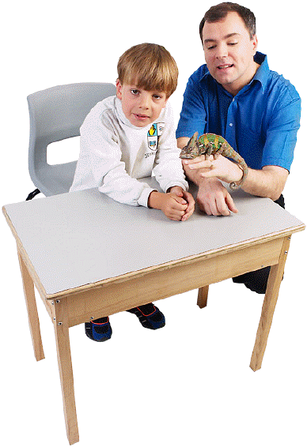
Long-Term Effects
It is unclear, however, whether security of attachment in infancy has a direct effect on later development, or whether early security of attachment predicts children’s functioning because “good” parents remain “good” parents
It is likely that children’s development can be better predicted from the combination of both their early attachment status and the quality of subsequent parenting than from either factor alone

Slide 17
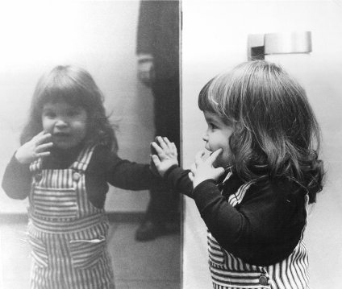
The Self
Refers to a conceptual system made up of one’s thoughts and attitudes about oneself
An individual’s conceptions about the self can include thoughts about one’s own physical being, social roles and relationships, and “spiritual” or internal characteristics
The ‘Rouge’ Test: young children recognise themselves by age 18-20 months.

Slide 18
The Developing Sense of Self
Children’s sense of self emerges in the early years of life and continues to develop into adulthood, becoming more complex as the individual’s emotional and cognitive development deepens
Adults contribute to the child’s self-image by providing descriptive information about the child
Self-esteem grows in relation to these factors

Slide 19
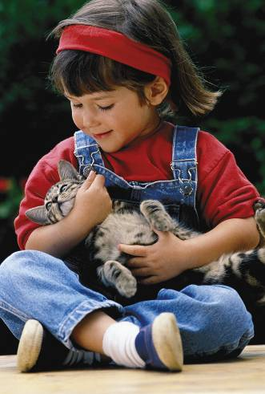
The Developing Sense of Self
Infants have a rudimentary sense of self in the first months of life, as evidenced by their control of objects outside of themselves
Their sense of self becomes more distinct at about 8 months of age, when they respond to separation from primary caregivers with separation distress

Slide 20
The Developing Sense of Self
By 18 to 20 months of age, many children can look into a mirror and realise that the image they see there is themselves
By 30 months of age, almost all children recognise their own photograph
By Two-years-old children’s exhibition of embarrassment and shame, their self-assertive behaviour, and their use of language also indicate their self-awareness

Slide 21
The Developing Sense of Self
At age 3 to 4, children understand themselves in terms of concrete, observable characteristics related to physical attributes, physical activities and abilities, and psychological traits
Their self-evaluations during the preschool years are unrealistically positive
Children begin to refine their conceptions of self in elementary school, in part because they increasingly engage in social comparison, the process of comparing aspects of one’s own psychological, behavioural, or physical functioning to that of others in order to evaluate oneself

Slide 22
The Developing Sense of Self
By middle to late elementary school, children’s conceptions of self begin to become integrated and more broadly encompassing, reflecting cognitive advances in the ability to use higher-order concepts
In addition, older children can coordinate opposing self-representations and are inclined to compare themselves with others on the basis of objective performance
In elementary school, children’s self-concepts are increasingly based on their relationships with others, especially peers, and others’ evaluations of them, making them vulnerable to low self-esteem

Slide 23
The Developing Sense of Self
The ability to use abstract thinking allows adolescents to think of themselves in terms of abstract characteristics that encompass a variety of concrete characteristics and behaviours
Adolescents can also conceive of themselves in terms of a variety of selves, depending on the context

Slide 24
The Developing Sense of Self
In early adolescence, thinking about the self is characterised by a form of egocentrism called the personal fable, a story that adolescents tell about themselves that involves beliefs in the uniqueness of their own feelings and their immortality
The kind of egocentrism that forms the basis for adolescents’ personal fables also causes many adolescents to be preoccupied with what others think of them
The imaginary audience refers to the belief that everyone is focused on the adolescent’s appearance and behaviour

Slide 25
The Developing Sense of Self
In their middle teens, adolescents often begin to agonise over the contradictions in their behaviour and characteristics
Most, however, still do not have the cognitive skills needed to integrate their recognition of these contradictions into a coherent conception of self

Slide 26
The Developing Sense of Self
In late adolescence and early adulthood, the individual’s conception of self becomes both more integrated and less determined by what others think
Older adolescents’ conceptions of self also frequently reflect internalised personal values, beliefs, and standards
Support and tuition from parents, teachers, and others is important in helping adolescents understand the complexity of personalities

Slide 27
Identity in Adolescence
As they approach adulthood, adolescents must begin to develop a sense of personal identity that incorporates numerous aspects of self
Includes their values and goals about the future, their political and religious beliefs, and sometimes their sexual identity

Slide 28
Erikson’s Views
Erik Erikson argued that the resolution of these many issues, the crisis of identity versus identity confusion, is the chief developmental task in adolescence
During this stage, the adolescent or young adult either develops an identity or experiences one of several negative outcomes:

Slide 29
Erikson’s Views
Identity confusion: An incomplete and sometimes incoherent sense of self, with resulting feelings of isolation and depression
Identity foreclosure: Can arise if adolescents prematurely commit themselves to an identity without adequately considering their choices
Negative identity: An identity that represents the opposite of what is valued by people around the adolescent

Slide 30
Erikson’s Views
Due to the complexity of achieving an identity in modern society, and because of the negative consequences of failing to do so, Erikson argued for the importance of a psychosocial moratorium
A time-out period during which the adolescent is not expected to take on adult roles and can pursue activities that lead to self-discovery
Only possible in some cultures and only to the more privileged classes

