Slide 1
Middle Age
– Life expectancy: 76 Mid-life : 38
– By 50s: mostly unnoticeable but persistent
declines in physical efficiency

Slide 2
Sensory and Physical Changes
Vision
Presbyopia: normal condition in which the lens of the eye starts to harden, losing its ability to accommodate as quickly as it did in youth untreated

Slide 3
Vision
.Glaucoma: increased pressure caused by
fluid buildup in the eye, can damage the
optic nerve and lead to blindness if untreated
.Cataracts: clouding of the lens, typically
occur in 30-50% of people over 65
.Floaters: Annoying floating spots; particles
suspended in the gel-like fluid that fills the
eyeball and generally do not impair vision
.Dry eye: stemming from diminished tear production can be uncomfortable and can beeased with drops
.Macular degeneration: first signs are faded, distorted or blurred central vision

Slide 4
Hearing
\
Decline in prebycusis: the ability to hear
high-pitched sounds such as speech
Cochlear damage due to prolonged
exposure to loud noises: hearing loss

Slide 5
Taste and Smell
􀂄 Reduction of taste buds
􀂄 Decline in sense of smell after 50
Appearance
􀂄 Periodontal disease: loss of teeth
􀂄 Skin becomes dryer thinner and less elastic
􀂄 Carcinomas
􀂄 Double-standard of aging: Men more “sophisticated” :
women, less kind expressions
􀂄 Cosmetics, cosmetic surgery
􀂄 Hair color, loss of hair

Slide 6
Body Composition
􀂄 Muscles begin to atrophy
􀂄 Weight
􀂄 Exercise and nutrition
􀂄 Osteoporosis: a disorder of thinning bone mass and microarchitectural deterioration of bone tissue

Slide 7
Rheumatoid Arthritis
􀂄 An inflammatory disease that causes pain, swelling, stiffness, and loss of function of the joints
Hormones
􀂄 Human Growth Hormone: powerful hormone used to treat children afflicted by dwarfism has become a trendy anti-aging potion

Slide 8
Menopause and Female Midlife Change
􀂄 Menopause: a process culminating in the cessation of menstrual activity
􀂄 Perimenopause: The time period preceding menopause
􀂄 Climacteric: Changes in the ovaries and hormonal processes
􀂄 45-55; average 51

Slide 9
Estrogen Replacement Therapy
Regimen often recommended to menopausal women by physicians to maintain cardiovascular fitness, low bone loss and slow memory loss
May increase incidence of breast cancer
Reproduction After Menopause
– Medical procedure makes it possible

Slide 10
Male Midlife Change
Prostate gland: enlargement of this gland located at the base of the urethra – makes urination difficult.
10% of men over 40
Universal in men at 60
Cancer of the prostate: Most common malignant cancer in North America
Impotence: the inability to have or sustain an erection

Slide 11
Health Changes
􀂄 Sleep
Certain drugs interfere with sleep patterns
􀂄 Cardiovascular Fitness
Blood Pressure: 1in 4 American adults has high blood pressure
􀂄 Can lead to arteriosclerosis, heart attack, enlarged heart, kidney
damage or stroke
Who is at Risk?
African Americans
Middle aged adult men,
Post-menopausal women

Slide 12
Lifestyle changes to reduce risks
􀂄 Healthy weight
􀂄 Eat food high in starch and fiber
􀂄 Increase activity level
􀂄 Choose foods lower in salt
􀂄 Drink alcohol in moderation
􀂄 Learn stress management skills

Slide 13
Cholesterol
􀂄 A waxy fat that occurs naturally in the body and is used to build the cell walls and make certain hormones
􀂄 How to reduce:
– Reduce fats in diet
– Increase activity level
– Stop smoking
Cancer
􀂄 80% of all cancers are caused by environmental factors
􀂄 Leading cause of death for females, ages 40-60 yrs.
􀂄 Smoking is the number one controllable cause of cancer

Slide 14
The Brain
􀂄 Stroke: or “brain attack” occurs when blood circulation to the brain fails
􀂄 Parkinson’s disease: motor system disorder
Alzheimer’s Disease
􀂄 Alzheimer’s disease: develops in middle adulthood but shows up after age 65
􀂄 Alcohol consumption: slows down brain activity, alertness, judgment, coordination and reaction time; increased risk of accident

Slide 15
HIV/AIDS
􀂄 Number of cases in midlife has been increasing
􀂄 Risk factors:
– Childhood sexual abuse
– Adolescent or adult sexual assault
– Female-to-Male transmission of HIV/AIDS
– Women higher risk to become infected

Slide 16
Female-to-Female Transmission of HIV/AIDS
􀂄 Of 85,500 women with HIV/AIDS, 1,648 were infected by other women
􀂄 Prevention: condoms
Stress and Depression
􀂄 2.2% of midlife adults experience major depression
􀂄 Associated with increased mortality and suicide

Slide 17
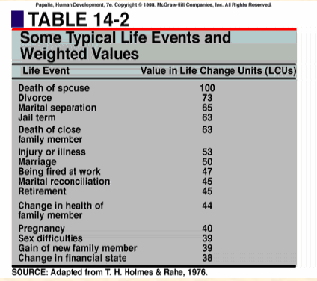

Slide 20
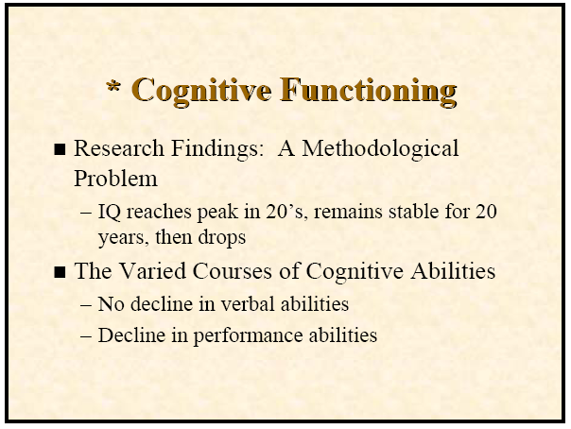

Slide 26
