Slide 1
Umpan Balik & Kompleksitas Dinamis
Roesfiansjah Rasjidin
Program Studi Teknik Industri
Fakultas Teknik – Univ. Esa Unggul

Slide 2
Keseluruhan > Penjumlahan Semua Bagian
Semua sistem kehidupan mempunyai sejumlah besar interaksi yang terkoneksi kuat
Dalam systems thinking, berbagai interaksi antar bagian dalam sistem akan memberikan peningkatan terhadap kualitas (qualities) atau karakteristik (properties)

Slide 3
Keseluruhan (The whole)
Tidak hanya berupa penjumlahan dari bagian-bagian yang ada pada sistem
Keseluruhan menjadi terganggu jika interaksi antar bagian dalam sistem diganggu
Ekosistem dan binatang-binatang dalam ekosistem

Slide 4
Contoh 1
Penangkapan ikan secara berlebihan akan mengurangi populasi ikan-ikan kecil yang menjadi makanan ikan paus. Sebagai pengganti, ikan paus akan memakan binatang laut lainnya. Seperti di pesisir pantai California, USA, orca (ikan paus) memangsa otter (anjing laut).
Dalam kondisi ekosistem laut yang seimbang, ikan paus dan otter hidup berdampingan secara damai, tidak sebagai pemangsa dan yang dimangsa

Slide 5
Contoh 2
Keseluruhan mobil melebihi sebuah rakitan komponen-komponen pembentuk mobil
Terdapat berbagai interaksi komponen-komponen mobil tersebut, yang menciptakan kualitas atau karakteristik lain, seperti kecepatan mobil, kenyamanan mobil, dan lainnya.

Slide 6
Emergent Property
Sebuah karakteristik atau perilaku yang terjadi karena interaksi antara sejumlah bagian tertentu dalam sistem
Contoh: sistem mobil (kecepatan, kenyamanan, ketahanan, keiritan), sistem orchestra, sistem drama, dan sistem sports team

Slide 7
Tujuan Sistem
Kebanyakan sistem mempunyai tujuan yang berbeda-beda terkait dengan sistem lebih besar dimana sistem berada
Contoh: sistem sosial pada sebuah sekolah (sistem yang ada pada tiap departemen di sekolah dapat memiliki tujuan yang berbeda-beda)

Slide 8
Kausalitas (Sebab dan Akibat)
Berbentuk linier
Contoh: sekumpulan domino yang jatuh

Slide 9
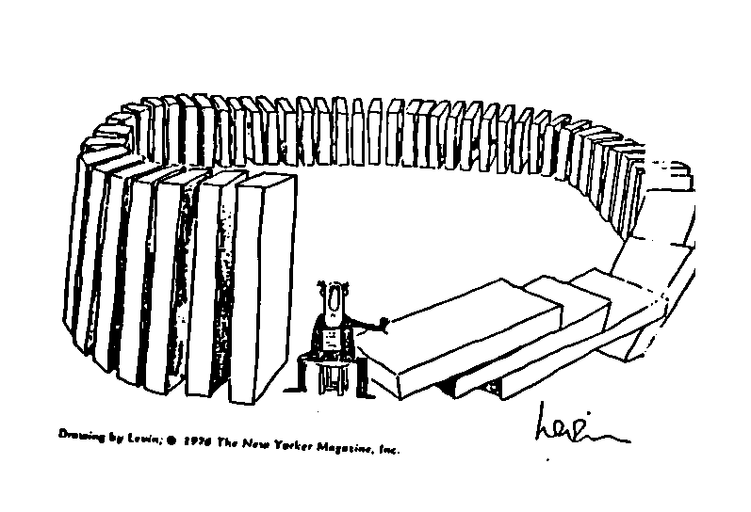

Slide 11
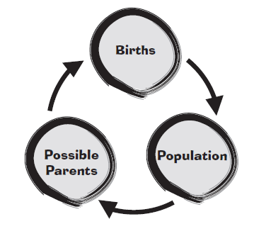
Kausalitas Lainnya
Berbentuk sirkular → feedback loops

Slide 12
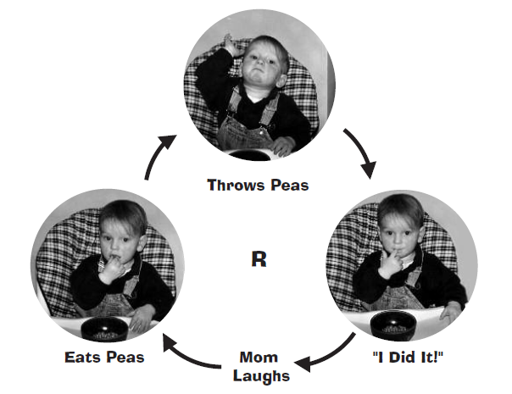
Reinforcing Loops

Slide 13
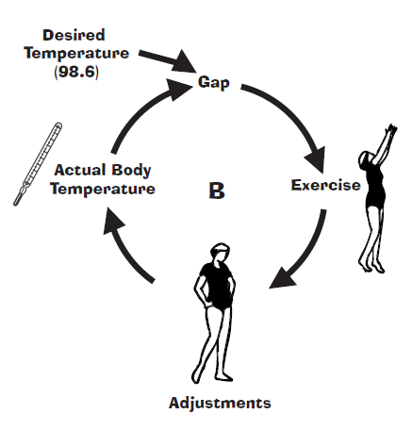
Balancing Loops

Slide 14
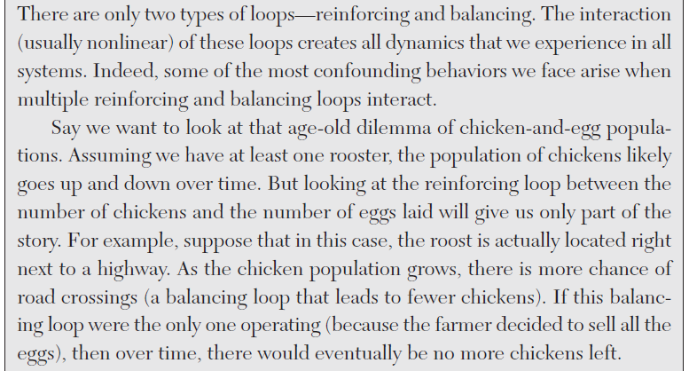
Counting Chickens in a Complex World

Slide 15
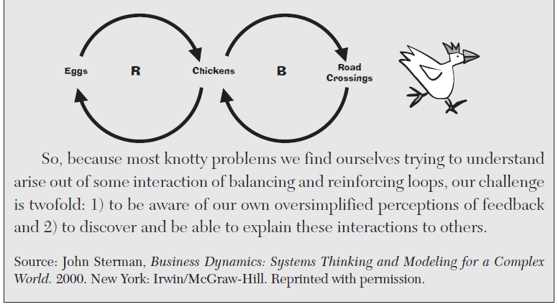
Counting Chickens in a Complex World

Slide 16
Complexity (Complex Systems)
Static complexity,  associated with problems of complex structure
Dynamic complexity,  associated with problems of complex behavior
Analytical complexity,  associated with problems that are difficult to evaluate

Slide 17
Static or Structural Complexity
The more elements comprise a system, the more complicated it becomes
For a crude example related to common human experience, consider sorting socks after doing the laundry. (Note: even if you just throw all of your socks in a drawer, you still have to face a version of this problem to find a matching pair when you get dressed.) The task is trivial: pick up any sock, then find its mate. For an ordinary laundry load this doesnt take long. Even trying to sort 30 pairs of socks is only a little bothersome; at first you may have to hunt around a bit, but it gets progressively easier. But consider sorting 300 pairs of socks, or 3 million.

Slide 18
Dynamic or Behavioral Complexity
System behavior will change in response to specific changes in inputs
Examples: anti-lock brakes in cars make drivers more aggressive, decreasing safety; fire-suppression policy results in more severe forest fires; low-tar cigarettes lead smokers to smoke more, increasing carcinogen intake, etc.

Slide 19
Dynamics
Over a long enough time frame, almost any aspect of a system can change; in a short enough period, none do. Unfortunately, key elements can change at dramatically different rates, making them difficult to judge. Causes and effects may be distant in time, and their relationships may change by the time their connections are recognized.

Slide 20
Coupling
Components of a system are said to be coupled. if changing one affects the other. Tightly coupled elements make it almost impossible to affect the intended target exclusively; any change also causes some other changes, each of which may cause still more changes, with each induced effect being less intentional and therefore potentially less predictable, recognizable, and controllable.

Slide 21
Feedback
The condition created by a causal loop of couplings. When a system involves feedback, a known change to a factor can eventually travel back and exert an additional change to the original factor. A single feedback loop can result in significantly greater or lesser effects than expected, if the feedback is not anticipated. Multiple loops, acting in different time frames, can result in practically unpredictable behavior.

Slide 22
Nonlinearity
When the changes in one or more outputs are not proportional to changes in the inputs. This is caused by coupling or feedback, and is primarily problematic because people rarely anticipate or fully understand nonlinear relationships.

Slide 23
Chaos
For our purposes, this is basically unpredictable behavior from a deterministic system. Chaotic systems are characterized by extreme sensitivity to initial conditions and unpredictable, aperiodic evolution (with some stable structure) instead of convergence to a steady-state. The classic description of chaotic behavior is the butterfly effect.

Slide 24
Adaptation
If the capabilities or preferences of actors within the system can evolve, (i.e., they learn from or actively respond to events), self-organization, self-selection, and co-evolution can result in sophisticated emergent behavior.

Slide 25
Analytical or Evaluation Complexity
Systems exhibiting analytical complexity involve value disputes and multidimensionality, complicating the evaluation of and choice between policy options

