Slide 1
Proses Pemodelan Sistem Dinamis
Roesfiansjah Rasjidin
Teknik Industri – FT - UEU

Slide 2
Tips untuk pemodelan System Dinamics
Identify the “real”problem (or purpose) and the “real”client
Build it small first and add complexity later
Work as closely as possible with your client
Do not try to build a “perfect”model
Modeling is iterative
Make it “simple”

Slide 3
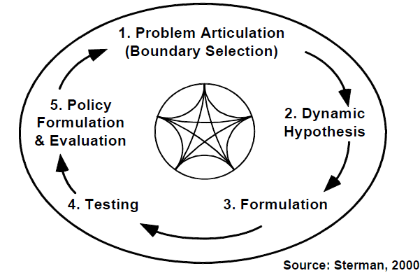
Tips untuk pemodelan System Dinamics
Modeling is iterative

Slide 4
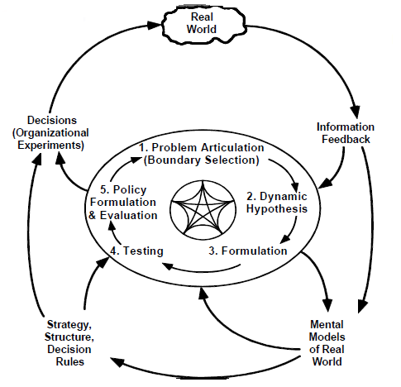
Tips untuk pemodelan System Dinamics
Modeling is embedded in the system
Source: Sterman, 2000

Slide 5
Proses pemodelan (modeling process)
Determine the purpose (problem you want to solve or understand by building the model)
Model boundaries
Key factors (variables and, in particular, stocks)
Time horizon
Reference modes (what is happening and what you would prefer to happen)

Slide 6
Proses pemodelan (modeling process)
Dynamics Hypothesis
What’s your theory (perceptions or understanding) about the current situation?
Endogenous, exogenous, and excluded variables
Subsystems
Policy-related structures
Formulation (based on the available information)

Slide 7
Proses pemodelan (modeling process)
Testing
Compare the model outputs with the reference modes
Robustness under extreme conditions
Reality check
Sensitivity

Slide 8
Proses pemodelan (modeling process)
Policy design and evaluation
What policies (options or portfolios of options) do you have
What do they cause
How do they interact

Slide 9
DISKUSI & TANYA JAWAB

