Slide 1
Model Persediaan Deterministik
Roesfiansjah Rasjidin
Program Studi Teknik Industri
Fakultas Teknik – Univ. Esa Unggul

Slide 2
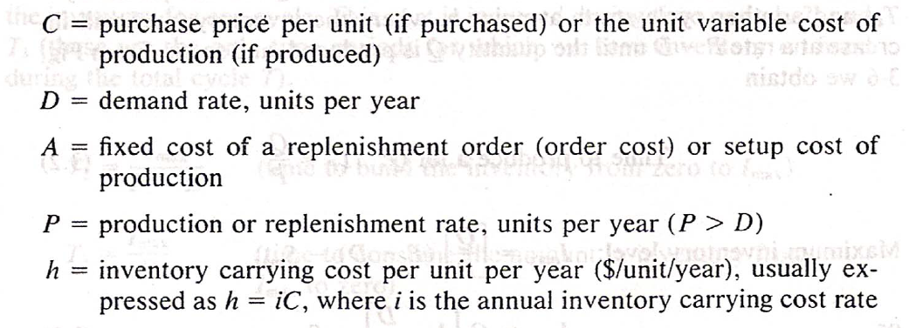
Notasi

Slide 3
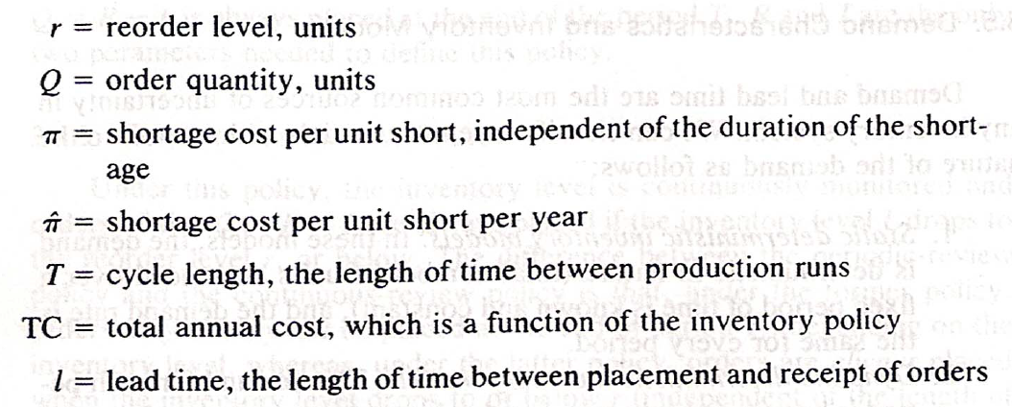

Slide 4
Model Produk Tunggal

Slide 5
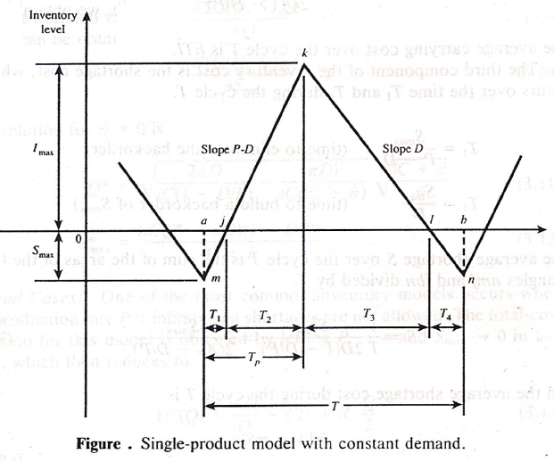
Ilustrasi Persediaan Deterministik Produk Tunggal

Slide 6
Deskripsi Sistem Persediaan Deterministik Produk Tunggal

Slide 7
Lot Production Time & Maximum Inventory Level
Time to produce a lot Q
Maximum inventory level

Slide 8
Order Cost & Carrying Cost

Slide 9
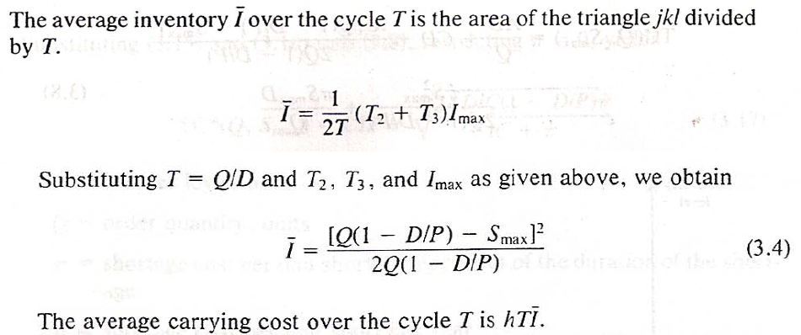
Carrying Cost

Slide 10
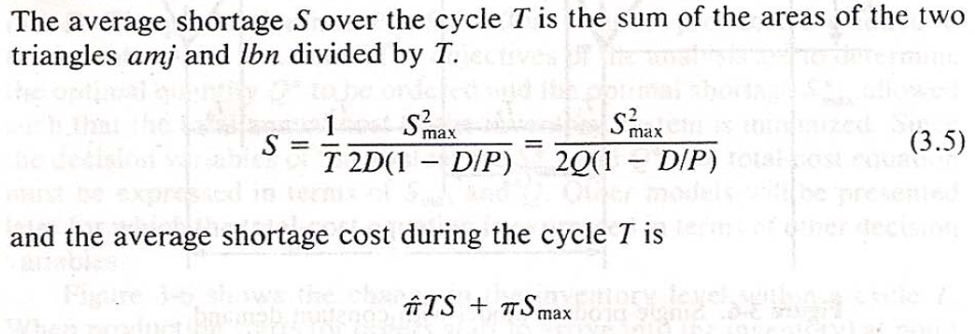
`
Shortage Cost

Slide 11
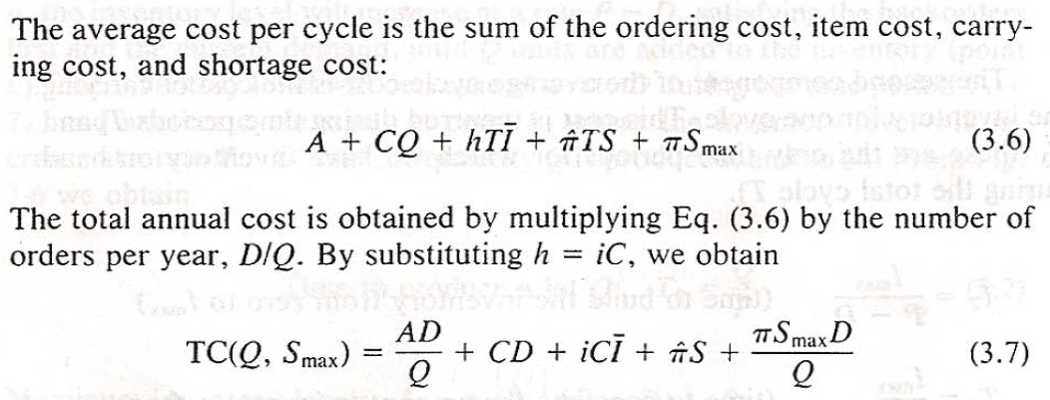
Total Cost

Slide 12
Decision Variables

Slide 13
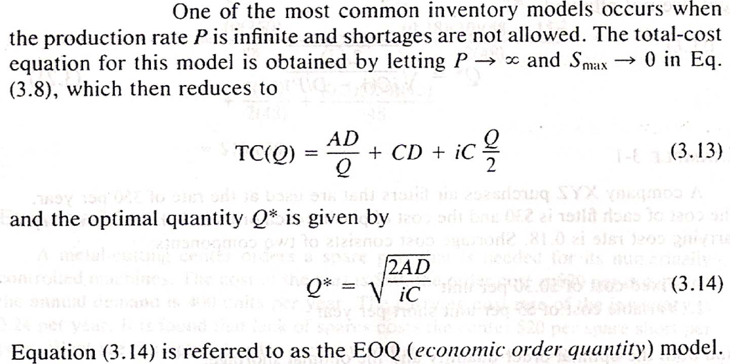
Special Case 1

Slide 14
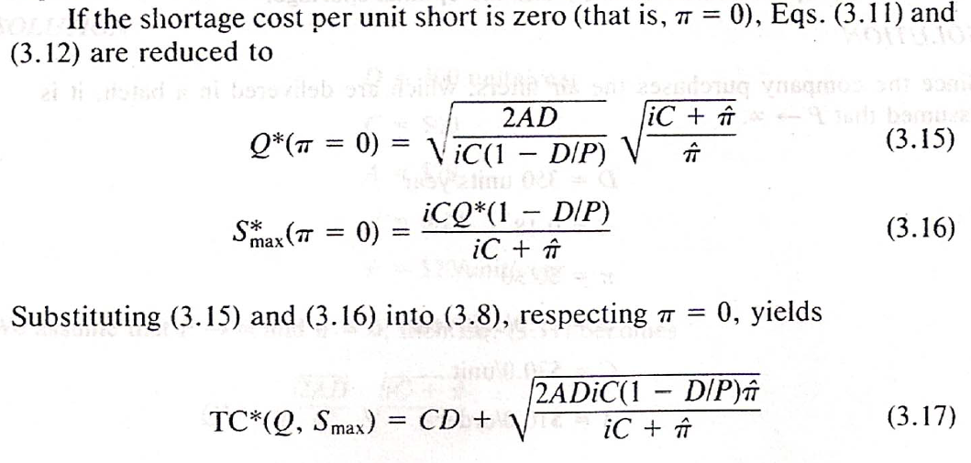
Special Case 2

Slide 15
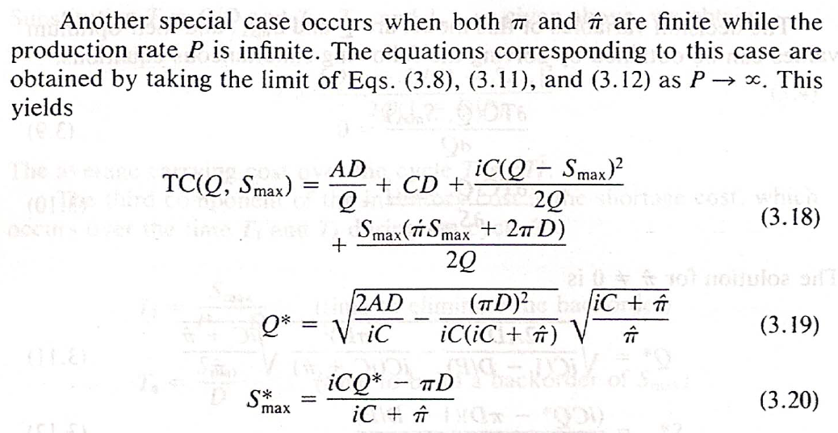
Special Case 3

Slide 16
Special Case 4

Slide 17
DISKUSI & TANYA JAWAB

