Slide 1
Maintainability
Materi

Slide 2
Introduction
There are two general types of maintenance : Reactive and Proactive Maintenance
Reactive maintenance is performed in response to unplanned or unscheduled downtime of the unit, ussually as a result of a failure.
Proactive maintenance may be either preventive and predictive maintenance.

Slide 3
Introduction
Preventive maintenance is scheduled downtime, ussually periodical in which a well defined set of task, such as inspection and repair, replacement, cleaning, lubrication, adjustment, and alignment performed.
Predictive maintenance estimates, through diagnotics tools and measurement, when a part is near failure and should be repaired or replaced, thereby eliminating a presumably more costly unscheduled maintenance action.

Slide 4
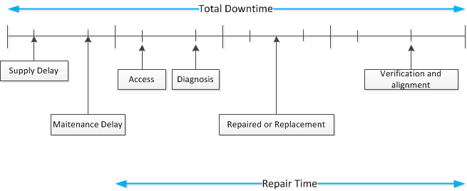
Analysis of Downtime

Slide 5
Repair Time Distribution
In order to quantify maintainability, the repair time distribution must be first defined.
The repair times can be created as random variables since repeated repair action will result in different repair times.
To quantify the repair time, let T be continous random variabel representing the time to repair a failed unit, having a probability density function of h(t). Then the cumulative density function is
$$\operatorname{Pr}\left\{T≤t\right\}=H\left(t\right)=\int_{0}^{t}{h\left(t^{′}\right)dt′}$$

Slide 6
Repair Time Distribution
The mean time to repair may be found from
$$MTTR=\int_{0}^{∞}{t h\left(t^{}\right)dt=\int_{0}^{∞}{\left(1−H\left(t\right)\right)dt}}$$
The variance of the repair distribution is found from
$$σ^{2}=\int_{0}^{∞}{{\left(t−MTTR\right)}^{2}h\left(t\right)dt}$$

Slide 7
Repair Time Distribution
Exponential repair times
If the repair distribution is exponential, then
$$H\left(t\right)=\int_{0}^{0}{\frac{e^{\frac{−t′}{MTTR}}}{MTTR}dt^{′}=1−e^{\frac{−t}{MTTR}}}$$
Lognormal Repair Times
If the repair distribution is lognormal, then
$$h\left(t\right)=\frac{1}{\sqrt{2πts}}e^{\frac{{[\ln\left(\frac{t}{t_{med}}\right)]}^{2}}{2s^{2}}} t>0$$

Slide 8
Repair Time Distribution
Lognormal Repair Times
$\operatorname{Pr}\left\{T≤t\right\}=H\left(t\right)=φ(\frac{1}{s}ln\frac{t}{t_{med}}$)
With MTTR can be found from,
$$MTTR=t_{med}e^{{s^{2}}/2}$$

Slide 9
Thank you......
For your attention............

