Slide 1
Reliability of system
Pertemuan Ke-5

Slide 2
Introduction
Serial
All component must function for the system to function
System configuration
Parallel
At least one component must function for the system to function

Slide 3
Serial Configuration
1
2
n
A system reliability Rs may be determined from the component reliability, in the following away:
E1= The event that component 1does not fail.
E₂= The event that component 2does not fail.
P(E₁)= R₁ and P(E₂)= R₂
Therefore, Rs= P (E₁n E₂)= P(E₁)P(E₂)= R₁R₂ . Assuming that the two component indepent ( its mean that tha failure or non failure at one component does not change reliability at other component)

Slide 4
Serial Configuration
Generally to n mutually indepedent component series.
Rs(t)= R₁(t)R₂(t).........R_{n}(t) ≤ min{R₁(t).R₂(t)....R_{n}(t)}
The system reliability can therefore to be greater than smallest component reliability.
If each component has a constant failure rate $λi$, the system reliability is given by.
Rs(t) =Exp (-$λ$st)

Slide 5
Serial Configuration
If the component failure are governed by the weibull failure law, then
Rs(t) =Exp$\left[−\sum_{i=1}^{n}{{\left(\frac{t}{θ_{i}}\right)}^{β_{i}}}\right]$ and
$$λ\left(t\right)=\sum_{i=1}^{n}{\frac{β_{i}}{θ_{i}}{\left(\frac{t}{θ_{i}}\right)}^{β_{i}−1}}$$

Slide 6
Parallel Configuration
1
Two or more component are in parallel or redundant configuration, if all units must fail for the system to fail
2
n

Slide 7
Parallel Configuration
Sistem reliability for n parallel and independent component is found by taking 1 minus probability that all n component fail. To see this for two component, consider
Rs = P(E₁UE₂)=1- (PE₁UE₂)^{c} = 1-P(E₁^{c}nE₂^{c})
Generallizing:
Rs= 1-$\prod_{i=1}^{n}{[(1−Ri\left(t\right)]}$
If is always true that
Rs(t)≥ Max{R₁(t),R₂(t),.....Rn(t)}

Slide 8
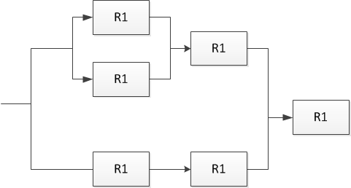
Combines Series Parallel Configuration
R_{A}= [1-(1-R₁)(1-R₂)]
R_{B} = R_{A}.R₃
R_{c} = R₄.R₅
R_{D} =R_{c}. R_{B}
R_{s} = R_{D}.R₆
A
B
D
C

Slide 9
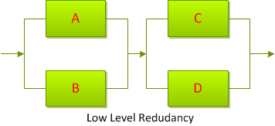
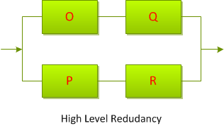
High Level Vs Low Level Redudancy
System redudancy may be obtained in two ways.
Each component comprising the system may have one or more parallel component.
The entire system may be placed in parallel with one or more identical systems.

Slide 10
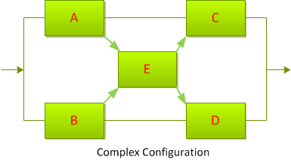
Complex Configuration
For certain system, the component configuration is such that the system reliability cannot be simply decomposed into series and parallel relationships.
However, this network can be analyzed by using either decomposition or enumeration.

Slide 11
Thank you......
For your attention............

